Slide 1
Active Agents:
An Active Inference Approach to Agent-Based Modeling in the Social Sciences
Welcome – Please access Colab script + Slides at:
https://github.com/apashea/IC2S2-Active-Inference-Tutorial
Andrew Pashea
Email: andrewbpashea@gmail.com
LinkedIn : https://www.linkedin.com/in/andrewbpashea/
Active Inference Institute Intern, https://www.activeinference.org/
Data Analyst, K-8 Public Charter School Network
UChicago Social Sciences Division Alum
Harris School of Public Policy Applied Data Fellow Alum
Notes:
# Textbook figures:
https://coda.io/d/ActInf-Textbook-Group_d4CkUI-iA_K/Figures_su1bB#Figure_tu1fA/r25

Slide 2
Overview: Tutorial Context and Caveats
Conference themes:
Agent-based modeling: from “traditional” to “cognitive” with hands-on code walkthrough
Cognitive science and theoretical discussions: applications of an established cognitive science framework, “Active Inference”, to CSS/ABM
No direct ‘ActInf for ABM’ framework nor multi-agent coding tutorial (currently) exists; so far most research is at an ‘advanced’ level
Reproducibility: developing intuitions and fundamental knowledge for reading and writing in Active Inference, open-source programming resources, open-source code for learning and adaptation
Format: Three Parts (with breaks!)
Part 1: Agent-based modeling
Some motivations and guidelines, The Cognitive Turn, RL, ActInf, comparisons and research examples
Part 2: Active Inference in-depth
Building intuition, cognitive mechanisms, ABC(DEFG)’s of Inference
Part 3: Learning by Doing
Code walkthrough: recreation of a ‘traditional’ ABM of parallel-problem solving in networks, now with ActInf agents
—--

Slide 3
Overview: Tutorial Context and Caveats
Preferred prerequisite knowledge:
Probability theory and distributions, e.g., sum to 1, non-negative probability values, categorical distributions, Bayesian theory
Optimization problems, e.g., predictive modeling, cost function minimization, gradient descent
Basic-to-intermediate programming, e.g., conditional logic, loops/iterations and algorithmic thinking, functions, Python lists/dictionaries/DataFrames
That said, we will be building agents from scratch
Developed as resource for learners at the Active Inference Institute:
‘Living document’: Not expected to remain the same; various tools are being developed for optimizing code and computational run-time
Some ‘slideshow karaoke’: slides should be comprehensible as a standalone resource for asynchronous learners
Not a holistic learning resource: Active Inference is vast and rapidly expanding into various domains; ‘further reading’ references provided
“As simple as possible, but not simpler”: ~3 hour conference tutorial is not enough to cover field holistically; we will cover various aspects (and maths involved) in a pragmatic fashion
intention: introduce ActInf to broader audience, providing intuition about the field as well as a more direct application example
—--

Slide 4
Agent-based Modeling: Key Terms & Overview
Agent-based modeling: ABMs are used in CSS to simulate and research social phenomena artificially. Artificial agents/entities are produced in an artificial environment, typically via computer programming, and interact with each other and their environment during simulations. This provides a safe, artificial environment for hypothesis-testing, theory-building, and counterfactual explorations in policy design and the study of emergent collective behavior prior to real-world implementation.
Micro-to-macro: By coding agents and their environment with the right sets of initial micro-level assumptions, ABMs can be used to study emergent macro-level phenomena resulting from collective behavior, e.g., social interaction, network dynamics, organizational productivity, spread of information/norms, housing segregation, impacts of financial crises, policy impact on behavior.
—--
Notes:
(Steinbacher et. al, 2021)https://link.springer.com/article/10.1007/s43546-021-00103-3
pp. 98-99: key terms (agent/environ, micro to macro)
“Despite their simplicity, controlled laboratory experiments allow for collecting data that in the real world are not available, like expectations formation or cognitive abilities or biases of human subjects that can be used to endow artifcial agents in ABMs with more realistic characteristics and behavior following, for example, adapting learning rules.”
“Rules and actions While interaction between agents can be adjusted by a plausible network, the rules of interaction with other agents and decision making processes are deduced from social and psychological theories or observations. For example, the Granovetter threshold theory—people follow a norm as long as a certain threshold of people in their neighborhood follow it—is often used to study the dynamics of norm adoption in a society (Granovetter 1978).”
(Gao et. al, 2023) https://arxiv.org/pdf/2312.11970
pp. 2-3: key terms (agent/environ, agent traits like autonomy)
(Lazer et. al, 2007)
“Agentbased modeling, a particular type of simulation modeling, is especially well suited to the study of organizational systems (Chang and Harrington, 2006). Agent-based modeling starts with a set of simple assumptions about agents’ behavior and inductively derives the emergent system-level behaviors that follow (Schelling, 1978; Macy and Willer, 2002)”

Slide 5
Agent-based Modeling: Key Terms & Overview
Agent: Fundamental entities in an agent-based model, e.g., individual persons, organisms, institutions. Agents are typically endowed with the ability to act in different ways, e.g., interact with other agents, approach/avoid, explore/exploit, move (in physical space), buy/sell. Agents may be endowed with various behavioral and demographic characteristics, typically in accordance with assumptions drawn from empirical findings, e.g., survival, goal-directedness, social conformity, utility-maximization, occupation, belief adherence.
Environment: Agents are situated in an environment, e.g., networks, social organizations, physical spaces, markets, or other niches. Agents interact with one another and the environment itself. The environment both constricts and provides affordances to agents, e.g., agents may only interact with other agents in their own (sub)network, agents cannot move outside the boundaries of a physical environment, agents find rewards in their environment.
Simulations: Simulations are coded to create the agents and their environment and then executed over some duration, typically over discrete time steps (t=1, t=2, …, t=T). Particular individual- and aggregate-results are recorded over time, e.g., individual agents’ actions taken at each time step, aggregated purchases/sales of all agents, average distance between moving agents, other use-case specific variables.
—--
Notes:
(Steinbacher et. al, 2021)https://link.springer.com/article/10.1007/s43546-021-00103-3
pp. 98-99: key terms (agent/environ, micro to macro)
“Despite their simplicity, controlled laboratory experiments allow for collecting data that in the real world are not available, like expectations formation or cognitive abilities or biases of human subjects that can be used to endow artifcial agents in ABMs with more realistic characteristics and behavior following, for example, adapting learning rules.”
“Rules and actions While interaction between agents can be adjusted by a plausible network, the rules of interaction with other agents and decision making processes are deduced from social and psychological theories or observations. For example, the Granovetter threshold theory—people follow a norm as long as a certain threshold of people in their neighborhood follow it—is often used to study the dynamics of norm adoption in a society (Granovetter 1978).”
(Gao et. al, 2023) https://arxiv.org/pdf/2312.11970
pp. 2-3: key terms (agent/environ, agent traits like autonomy)
(Lazer et. al, 2007)
“Agentbased modeling, a particular type of simulation modeling, is especially well suited to the study of organizational systems (Chang and Harrington, 2006). Agent-based modeling starts with a set of simple assumptions about agents’ behavior and inductively derives the emergent system-level behaviors that follow (Schelling, 1978; Macy and Willer, 2002)”

Slide 6
Agent-based Modeling: Some Traditional Guidelines
Lazer & Friedman (2007): “Agent-based modeling starts with a set of simple assumptions about agents’ behavior and inductively derives the emergent system-level behaviors that follow.” Four guideline criteria for ABMs (applicable to experimental research in general) are as follows:
Verisimilitude: The constrained assumptions made must be convincing to readers, typically via being based on empirical findings in the literature. “For example, if one does not believe that the two-actor, two-choice set up of the prisoner’s dilemma captures important features of some human relations, then the rather plentiful (analytic and simulation) research on the prisoner’s dilemma has nothing to say about collective behavior.”
Robustness: Models should be relatively simple enough such that “results should withstand unimportant changes to the model.” Excessive complexity compromises the model’s generalizability to the phenomena of interest.
—--
Notes:
(Lazer et. al, 2007)
pp. 672-673: four critera (verisimilitude, robustness, reproducibility, non-triviality)
“Agentbased modeling, a particular type of simulation modeling, is especially well suited to the study of organizational systems (Chang and Harrington, 2006). Agent-based modeling starts with a set of simple assumptions about agents’ behavior and inductively derives the emergent system-level behaviors that follow (Schelling, 1978; Macy and Willer, 2002)”
Box: Box repeated the aphorism twice more in his 1987 book, Empirical Model-Building and Response Surfaces (which was co-authored with Norman Draper).[4] The first repetition is on p. 74: "Remember that all models are wrong; the practical question is how wrong do they have to be to not be useful." The second repetition is on p. 424, which is excerpted below.
... all models are approximations. Essentially, all models are wrong, but some are useful. However, the approximate nature of the model must always be borne in mind....

Slide 7
Agent-based Modeling: Some Traditional Guidelines
Lazer & Friedman: “Agent-based modeling starts with a set of simple assumptions about agents’ behavior and inductively derives the emergent system-level behaviors that follow.” Four guideline criteria for ABMs (applicable to experimental research in general) are as follows:
3. Reproducibility: The model results must be fully reproducible by other researchers based on information in the paper, as well as from reasonably commented code for the simulation made available online.
4. Non-triviality: The results of the simulation should be non-obvious. “The objective of computational modeling should not be to reproduce what could be derived from verbal exposition; rather, it is to produce novel yet convincing insight.”
—--
Notes:
(Lazer et. al, 2007)
pp. 672-673: four critera (verisimilitude, robustness, reproducibility, non-triviality)
“Agentbased modeling, a particular type of simulation modeling, is especially well suited to the study of organizational systems (Chang and Harrington, 2006). Agent-based modeling starts with a set of simple assumptions about agents’ behavior and inductively derives the emergent system-level behaviors that follow (Schelling, 1978; Macy and Willer, 2002)”
Box: Box repeated the aphorism twice more in his 1987 book, Empirical Model-Building and Response Surfaces (which was co-authored with Norman Draper).[4] The first repetition is on p. 74: "Remember that all models are wrong; the practical question is how wrong do they have to be to not be useful." The second repetition is on p. 424, which is excerpted below.
... all models are approximations. Essentially, all models are wrong, but some are useful. However, the approximate nature of the model must always be borne in mind....

Slide 8
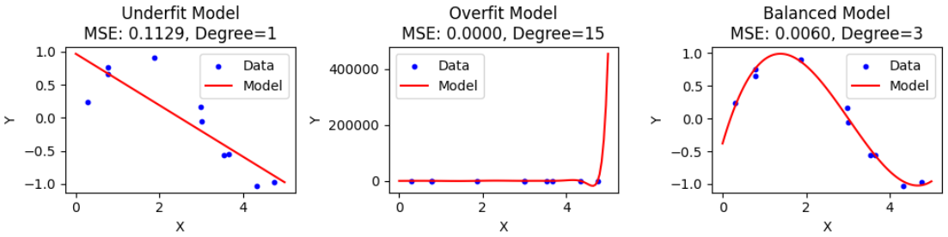
Agent-based Modeling: Some Pragmatic Guidelines
—--
Analogous to the simplicity-complexity or underfitting-overfitting trade-offs in modelling in general, e.g., bias-variance or under-/over-fitting tradeoff in statistical modelling and machine/deep learning, theoretical models in social sciences, engineering design, biological systems modelling, …
Example: fitting models with too few/many parameters
Notes:
Box et. al, Statistical Control By Monitoring and Adjustment (2nd ed., 2009), p. 61
Korzybski, “A Non-Aristotelian System and Its Necessity for Rigour in Mathematics and Physics”, in Science and Sanity, 1933,

Slide 9
Agent-based Modeling: Some Pragmatic Guidelines
—--
“Everything must be made as simple as possible, but no simpler.”
- Albert Einstein (purportedly)
“All models are approximations. Assumptions, whether implied or clearly stated, are never exactly true. All models are wrong, but some models are useful. So the question you need to ask is not ‘Is the model true?’ (it never is) but ‘Is the model good enough for this particular application?”
- statistician George E. P. Box
“A map is not the territory it represents, but, if correct, it has a similar structure to the territory, which accounts for its usefulness.”
- general semanticist Alfred Korzybski
Notes:
Box et. al, Statistical Control By Monitoring and Adjustment (2nd ed., 2009), p. 61
Korzybski, “A Non-Aristotelian System and Its Necessity for Rigour in Mathematics and Physics”, in Science and Sanity, 1933,

Slide 10
Agent-based Modeling: Too Simple?
“Simple as possible but no simpler” may be sufficient for approximating the bottom-up process of micro-level assumptions to macro-level emergent behavior, but how does this impact the agent?
“Traditional” ABMs tend to “hard-code” agent behavior with static rules-based action-selection as determined by the behavioral assumptions made on the part of the researcher, e.g., “if X then agents does Y” at each discrete time step, regardless of circumstance. It is “as if” agents adapt, but they do not functionally change or ‘learn’. A thermostat is a thermostat anywhere…
—--
Notes:
With the simplicity-complexity trade-off in mind, advances have been made to make agents more cognitively complex…
(Conte et. al, 2014) https://www.frontiersin.org/journals/psychology/articles/10.3389/fpsyg.2014.00668/full
“the generative power of ABM is found to have been underexploited, as the pressure for simple recipes has prevailed and shadowed the application of rich cognitive models”
“Through Google or Yahoo we may trace people's habits, moods, investment decisions, political views, risk propensity and attitudes toward culture, education and migration. Based on this information, we may drive production, capital movements, business strategies, political decisions, and international cooperation. But we will not be able to suggest effective plans for modifying such behaviors and the underlying mental states, unless we understand the mental dynamics and how this interacts with the social dynamics, and model the cognitive mechanisms that respond to external influence and rule behavioral change. In absence of such theory and model, we will not get to the core of hard problems”
“However, the circuit may be completely different: agents may resist pressure to change opinions despite contrasting evidence for reasons of cognitive dissonance. The more the contrasting evidence they gather, the higher the dissonance. To reduce it, they try to ignore evidence that is less costly than change opinion, which imply dropping the previous commitment and making a new one.

Slide 11
Agent-based Modeling: Too Simple?
This presents limits of applying “traditional” ABM to simulations and/or policy design directed at individuals’ beliefs, e.g., fostering student confidence, influencing financial overconfidence, mitigating self-damaging behaviors.
Cognitive decision-making inferences and predictions are predominantly left to empirical data retrieval and analysis, a rich and growing field nonetheless divorced from the simplisticity of traditional ABM model design.
“Through Google or Yahoo we may trace people's habits, moods, investment decisions, political views, risk propensity and attitudes toward culture, education and migration. Based on this information, we may drive production, capital movements, business strategies, political decisions, and international cooperation. But we will not be able to suggest effective plans for modifying such behaviors and the underlying mental states, unless we understand the mental dynamics and how this interacts with the social dynamics, and model the cognitive mechanisms that respond to external influence and rule behavioral change. In absence of such theory and model, we will not get to the core of hard problems” (Conte et. al, 2014).
—--
Notes:
(Conte et. al, 2014) https://www.frontiersin.org/journals/psychology/articles/10.3389/fpsyg.2014.00668/full
“the generative power of ABM is found to have been underexploited, as the pressure for simple recipes has prevailed and shadowed the application of rich cognitive models”
“Through Google or Yahoo we may trace people's habits, moods, investment decisions, political views, risk propensity and attitudes toward culture, education and migration. Based on this information, we may drive production, capital movements, business strategies, political decisions, and international cooperation. But we will not be able to suggest effective plans for modifying such behaviors and the underlying mental states, unless we understand the mental dynamics and how this interacts with the social dynamics, and model the cognitive mechanisms that respond to external influence and rule behavioral change. In absence of such theory and model, we will not get to the core of hard problems”
“However, the circuit may be completely different: agents may resist pressure to change opinions despite contrasting evidence for reasons of cognitive dissonance. The more the contrasting evidence they gather, the higher the dissonance. To reduce it, they try to ignore evidence that is less costly than change opinion, which imply dropping the previous commitment and making a new one.

Slide 12
Agent-based Modeling: Shift to Cognitive Models
“Traditional” ABMs:
Rules-based action-selection: “If this then agent does X, else agent does Y” without internal beliefs or mechanisms for autonomous action
Micro-level assumptions are kept as simple as possible, ‘hard-coded’ into simulations without real mechanisms for ‘learning’ / ‘training’
Macro-level behavior ideally mirrors empirical research, with insights yielded from modifying environment
NetLogo as predominant software
with specific syntax and lacking external tool integration.
“Cognitive” ABMs:
Autonomous action-selection: “Generative” agents choose own actions based on internal cognitive mechanisms, e.g., perception, action, learning, planning
Interdisciplinary work related to behavior in complex systems, e.g., cognitive science, psychology, physics and information theory, cybernetics machine-/deep-/reinforcement learning, biology, behavioral economics
Macro-level behavior ideally mirrors empirical research, with insights yielded from modifying environment and reviewing agents’ internal parameter changes
Various languages used, e.g., MATLAB, Python, julia.
—--
Notes:
With the simplicity-complexity trade-off in mind, advances have been made to make agents more cognitively complex. Here are some comparisons between traditional and cognitive agents…
(Gao et. al, 2023) https://arxiv.org/pdf/2312.11970
section 2.1.2: Agent capability: key terms+definitions for Autonomy, Social ability, reactivity,, pro-activeness
(Conte et. al, 2014) https://www.frontiersin.org/journals/psychology/articles/10.3389/fpsyg.2014.00668/full
“the generative power of ABM is found to have been underexploited, as the pressure for simple recipes has prevailed and shadowed the application of rich cognitive models”
“Through Google or Yahoo we may trace people's habits, moods, investment decisions, political views, risk propensity and attitudes toward culture, education and migration. Based on this information, we may drive production, capital movements, business strategies, political decisions, and international cooperation. But we will not be able to suggest effective plans for modifying such behaviors and the underlying mental states, unless we understand the mental dynamics and how this interacts with the social dynamics, and model the cognitive mechanisms that respond to external influence and rule behavioral change. In absence of such theory and model, we will not get to the core of hard problems”
“However, the circuit may be completely different: agents may resist pressure to change opinions despite contrasting evidence for reasons of cognitive dissonance. The more the contrasting evidence they gather, the higher the dissonance. To reduce it, they try to ignore evidence that is less costly than change opinion, which imply dropping the previous commitment and making a new one.

Slide 13
Agent-based Modeling: Cognitive Models
Perception: agents take environmental observations into account, in some representational form, e.g., probability distribution or table of values, which could be viewed as “beliefs,” “expectations,” or “predictions” with some memory mechanisms for storing this information and cognitive mechanisms and parameters for computing and learning representations.
e.g., ML/DL models, train/test data for model optimization
Action: paired with perception, whereby given some observation(s) the agent chooses actions to achieve its goals; as with perception, such experiences can also be stored in memory and used to develop complex strategies which are not “hard-coded”, i.e. not necessarily expected by the modeler a priori
e.g., RL agents, learning action selection via reward signals
Generative: Agents are “generative” and tend to rely upon (often probabilistic) representations of observation-action, action-reward, and/or other variable mappings; they learn and update their own figurative “if X then do Y” rules adaptively (which may or may not include stochasticity) and generate actions given some input (state or observation)
--
Notes:
Key mechanisms and characteristics of cognitive agents can be described as follows…
(Gao et. al, 2023) https://arxiv.org/pdf/2312.11970
pp. 2-3: key terms (agent/environ, agent traits like autonomy)
(Steinbacher et. al, 2021)https://link.springer.com/article/10.1007/s43546-021-00103-3
pp. 98-99: key terms (agent/environ, micro to macro)

Slide 14
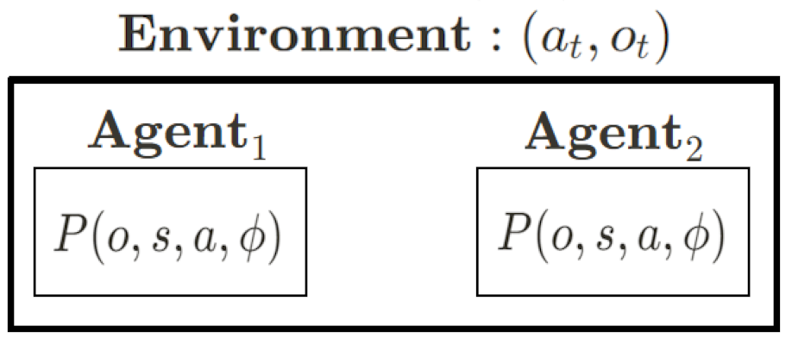
Agent-based Modeling: Cognitive Models
Models in a model: Cognitive/generative ABM agents thus require some model architecture for processing observations and algorithms for determining system behavior, e.g., optimization problem, reward/cost functions) – forming agents as (equipped with) generative models.
Our environment, with its own variables and parameters, now contains agents with their own variables and parameters.
--
Notes:
This presents a kind of paradigm shift in how we conceptualize agent-based models…
So, what happens when we apply cognitive models to agent-based modeling? …
(Gao et. al, 2023) https://arxiv.org/pdf/2312.11970
pp. 2-3: key terms (agent/environ, agent traits like autonomy)
(Steinbacher et. al, 2021)https://link.springer.com/article/10.1007/s43546-021-00103-3
pp. 98-99: key terms (agent/environ, micro to macro)

Slide 15
Agent-based Modeling: Cognitive Models
Some criteria: So, which model architecture and which algorithms?
Back to Lazer & Friedman:
Simplicity-complexity trade-off?
Empirical/theoretical support for the cognitive mechanisms?
Reproducible? Computational costs?
Model/parameter interpretability? Is it useful?
Explore-exploit trade-off: With perception, action, and other cognitive mechanisms in place, autonomous agents require using actions to both gain information about rewards and to actually achieve reward
Too much exploration -> less accumulated reward, risk info optimum
All day studying, not a page written…
Too much exploitation -> risk stuck at local reward optimum
…or write a terrible book-length essay without references
What is optimality? Task-performance and/or relative to the model itself?
Is suboptimal/pathological behavior a sign of the agent not doing what the experimenter desires, or is this in fact “optimal” to the model? …are we building superhumans?
--

Slide 16
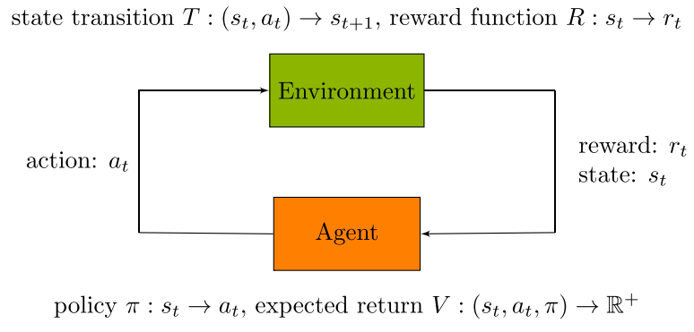
Which algorithms and architectures?
Reinforcement learning:
Class of algorithms which attempt to maximize a specific reward/cost function, the discounted sum of future expected rewards (Sutton et. al, 1998).
‘Model-free’ Q-learning: learn/update values of state-action pairs based on reward signal, without own model of transition probabilities or reward functions in advance.
Q-learning agents update their ‘Q-tables’, with valuations of state-action pairs as the primary interpretable parameters.
Computational costs are relatively low at this level of complexity.
(Emmert-Streib et. al, 2022).
Notes:
Richard S Sutton and Andrew G Barto. Reinforcement learning: An introduction. MIT Press, Cambridge, 2018.
Emmert-Streib, F., & Dehmer, M. (2022). Taxonomy of machine learning paradigms: A data-centric perspective. WIREs Data Mining and Knowledge Discovery, 12(5), e1470.

Slide 17
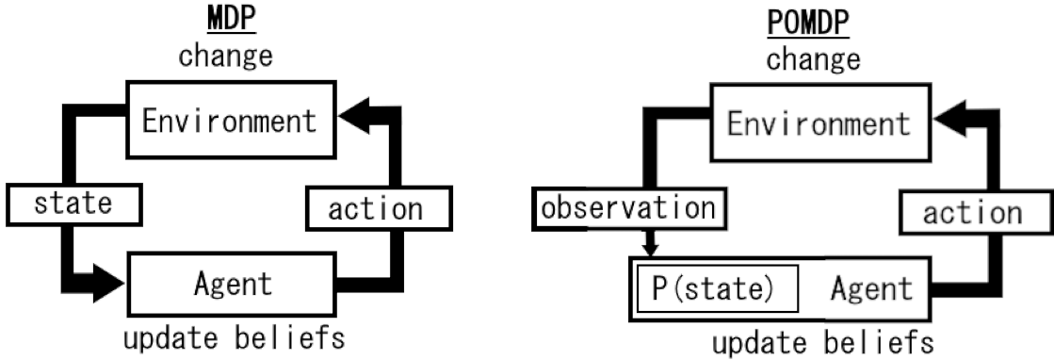
Which algorithms and architectures?
Typical base models:
Markov Decision-Making Process (MDP) : Environmental state is known to agent, i.e. uncertainty is only in the action-state reward valuations. Only uncertainty involved is in agent’s reward valuations of action-state pairs.
Partially-Observable Markov Decision-Making Process (POMDP) : Environmental state is unknown, only inferred from (potentially noisy) observations, mirroring higher cognitive realism. Agents maintain and update/learn a probability distribution–its beliefs–over these “hidden” or “latent” states, based on observations (Meng et. al, 2021). This is frequently handled with more NN-related features, increasing computational complexity/cost.
—--
Notes:
Meng, L., Gorbet, R., & Kulić, D. (2021). Memory-based Deep Reinforcement Learning for POMDPs. arXiv preprint arXiv:2102.12344.

Slide 18
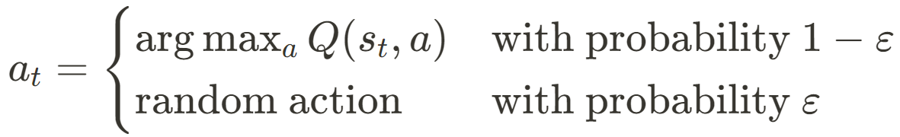
Which algorithms and architectures?
Reinforcement learning:
Task-performance optimization: Research typically focuses on task performance optimization in other fields, e.g., robotics, AI tools and assistants.
Pavlovian learning: Some RL algorithms relatable to early Pavlovian conditioning models (better-than-expected outcomes strengthen associations between predictors and outcomes) (Collins, 2019).
…but modeling/incorporating human cognition is often non-priority or niche.
Deeper -> more opaque: Research trends towards ‘deep’ RL, using features and architectures from, for example, neural networks to approximate reward functions, but this risks ‘black box’ interpretability loss and rising computational costs.
Exploration/exploitation dilemma: Treated as separate problems, with additional rules for deciding, e.g., epsilon-greedy behavior, manually defining an exploration rate ‘epsilon’ to avoid behaviors which are repetitive or suboptimal (locally optimal) to the task.(Tijsma, 2016).
—--
Notes:
Collins 2019, “Reinforcement learning: bringing together computation and cognition” (-> https://ccn.studentorg.berkeley.edu/pdfs/papers/computation_and_cognition_AGEC.pdf)
cites Sutton RS, Barto AG: Reinforcement Learning. MIT Press; 1998: :RL is a ‘class of algorithms [which] attempt to maximize a specific cost function…
relation to pavlov
Tijsma et. al, Comparing Exploration Strategies for Q-learning in Random Stochastic Mazes, 2016 (published by IEEE, also at https://www.ai.rug.nl/~mwiering/GROUP/ARTICLES/Exploration_QLearning.pdf)
“Too much exploration yields a lower accumulated reward, while too much exploitation can lead to the agent being stuck in a local optimum. This problem is known as the exploration/exploitation dilemma [3]–[5]. Because exploration may waste time exploring an irrelevant part of the environment, exploitation must happen simultaneously. One of the most widely used exploration strategies is -greedy [6]. The advantage of this strategy is that it is not dependent on specific data such as counters [7] and as an allround exploration strategy, epsilon-greedy is often hard to beat [8].”

Slide 19
Which algorithms and architectures?
Active Inference:
Normative Framework: A normative framework derived from first principles for studying the behavior of autonomous agents in situations requiring decision-making under uncertainty. Agents are equipped with generative models and take in observations from their environment which in turn are evaluated as (dis)confirmatory evidence for their current beliefs (Friston, textbook; and Sajid et. al, 2021). This begins with free energy principle (FEP): “everything that changes in the brain must minimize free energy” (Friston, 2022; Friston, 2009; and Sajid et. al, 2021).
Neural process theory: Foundations in computational neuroscience and study of neuronal dynamics and cognitive processes (including psychopathology, perception, decision-making) in animal and human behavior and in self-organizing systems more broadly. Abstract mathematical quantities – predictions, prediction errors, precision signals, etc. – manifest in neuronal dynamics, with physiological substrates (brain/organ activity and connectivity). FEP extends beyond minute continuous operations to homeostatic regulation in living organisms (Pezzulo et. al, 2015).
Generative models and no simpler: As a normative, principled framework, it has a top-down design philosophy. Rather than emulating the brain in its entirety, the challenge rather is “to find the generative model that describes the problem the brain is trying to solve.” (Friston et. al, 2022, pp. 104-105).
—--
Notes:
Parr, T., Pezzulo, G., & Friston, K. J. (2022). Active inference: The free energy principle in mind, brain, and behavior. The MIT Press
Friston, K. (2009). “The free-energy principle: a rough guide to the brain?” Trends in Cognitive Sciences 13(7): 293–301.
Pezzulo, G., Rigoli, F., & Friston, K. (2015). Active Inference, homeostatic regulation and adaptive behavioural control. Progress in Neurobiology, 134, 17-35.
(Sajid et. al, 2021): Active Inference: Demystified and Compared, Neural Computation, MIT Press, 2021.

Slide 20
Which algorithms and architectures?
Active Inference:
Free Energy principle (FEP): Agents minimize a theoretical quantity “free energy,” equivalent to maximizing evidence for current beliefs (as opposed to expressly maximizing ‘reward’) in order to, e.g., infer states, evaluate actions, update own model of the world (observation and transition models). This leads to a (Bayesian) belief-based framework and naturally emergent adaptive behaviors.
(Bayesian) ‘surprise’ is the true quantity to be minimized but is typically intractable; free energy acts as an upper bound on surprise
Exploration-exploitation balance: ‘Epistemic’ value and ‘pragmatic’ value included in same optimization problem for agents with capacity for planning (optimizing expected free energy) rather than handled separately as in, say, epsilon-greedy RL agents. In fact action, perception, and other cognitive mechanisms are all linked together and play out in continuous free energy minimization.
“Self-evidencing” agents: Instead of external reward signals, agents seek to realize preferences conceptualized as prior beliefs over observations, relatable to “goals.” Agents can learn which observations are more rewarding, i.e. those which help free energy minimization or equivalently maximize model evidence (Sajid et. al, 2021).
Variational (Bayesian) inference schemes are used to mitigate heavy computational costs and/or potential intractability in optimization operations – not ad hoc but rather with conceptual foundations in metabolic constraints of biological organisms.
—--
Notes:
Parr, T., Pezzulo, G., & Friston, K. J. (2022). Active inference: The free energy principle in mind, brain, and behavior. The MIT Press
(Sajid et. al, 2021): Active Inference: Demystified and Compared, Neural Computation, MIT Press, 2021.

Slide 21
Which algorithms and architectures?
Active Inference:
Optimality defined as relative to the model, not the task: Like “traditional” ABM, emphasis on recreating empirical dynamics rather than superior task performance, evidential for example in the inclusion of ‘false inference’:
a failure/aberration of belief updating: “linking together maladaptive behavior (e.g., compulsions or addictions) and psychological-level (e.g., false beliefs) and biological-level phenomena (e.g., abnormalities of neuromodulators).”
in psychopathology, “the inferential mechanism operates normally, but based on a flawed generative model” (Friston, 2022, pp. 186-187).
Competitive: albeit when compared, Active Inference agents typically rival or outcompete (Q-learning and Deep Q-Learning) RL agents in task performance, even when disadvantaged vs. RL agents, e.g., less time spent training, initialized with imprecise beliefs about environmental state transitions (Paul et. al, 2022).
Model architectures: As with RL, typical baseline discrete-time models are the MDP and POMDP, built up from the HMM as a model of cognitive perception augmented with the capacity for action and planning…
…but – like RL agents – can be augmented with other architectures as well. Further, variational message passing schemes can hypothetically be applied to any model writeable as a factor graph
—--
Notes:
(Sajid et. al, 2021): Active Inference: Demystified and Compared, Neural Computation, MIT Press, 2021.
Paul et. al, 2022. “Active Inference for Stochastic Control,” in Machine Learning and Principles and Practice of Knowledge Discovery in Databases, Springer International Publishing.

Slide 22
Active Inference and ABM: The Mindset
“Equipped with a mechanism to produce actions, an organism can engage in reciprocal exchanges with its environment…. Essentially, for each action-perception cycle, the environment sends an observation to the organism. The organism uses (an approximation to) Bayesian inference to infer its most likely hidden states. It then generates an action and sends it to the environment in an attempt to make the environment less surprising. The environment executes the action, generates a new observation, and sends it to the organism. Then, a new cycle starts.” Though able to be described as a step-wise cyclical process in this way, this is considered to be a continuous process occurring in various timescales, where discrete-time approximates to continuous.
“Active Inference goes beyond the recognition that perception and action have the same (inferential) nature. It also assumes that both perception and action cooperate to realize a single objective–or optimize just one function–rather than having two distinct objectives, as more commonly assumed. …described in various (informal and formal) ways, including the minimization of surprise, entropy, uncertainty, prediction error, or (variational) free energy.” (Friston et. al, 2022).
—--
Notes:
Firston, textbook, pp.24-25

Slide 23
Active Inference and ABM: Scaling and Compatibility
Agent in an agent: As the free energy principle (FEP) plays out in broader/global systems – e.g., organisms, agents, collectives, including within each constituent subsystem – the overall free energy of the system will be continuously minimized. Here, (sub)systems are considered to be (modelled as) self-organizing entities who are statistically separable from one another by a Markov blanket (as we will see), where each subsystem is (equipped with) its own generative model. (Friston et. al, 2022).
Goal-directed, self-evidencing and self-organizing agents range from homeostasis-seeking behavior of cellular organisms up to collective human social and cultural practices (Friston et. al, 2022; and Bruineberg et al. 2018).)
Ex. Neurons, brains and other organs, individuals, societies, …
—--
Notes:
Firston, 2022, pp.24-25
Bruineberg, J., E. Rietveld, T. Parr, L. van Maanen, and K. J. Friston (2018). “Freeenergy minimization in joint agent-environment systems: a niche construction perspective.” Journal of Theoretical Biology 455: 161–178

Slide 24
Active Inference and ABM: Scaling and Compatibility
Further reading on Active Inference in relation to FEP/RL/DL/LLMs:
“Reward Maximization Through Discrete Active Inference” (Da Costa et. al, 2023).
deeper comparison to RL and review of conditions under which Active Inference agents can be seen to be expressly maximizing reward (Bellman optimality)
“Canonical neural networks perform active inference” (Isomura et. al, 2022).
“Experimental validation of the free-energy principle with in vitro neural networks” (Isomura et. al, 2023).
“The Neural Correlates of Ambiguity and Risk In Human Decision-Making Under an Active Inference Framework” (Zhang et. al, 2024).
Theoretical, in vitro, and neuroimaging experimental validations of neural networks exhibiting the free energy principle (maximizing model evidence; learning and plasticity)
“Generative agent-based modeling: an introduction and tutorial” (Ghaffarzadegan et. al, 2024).
“Generating meaning: active inference and the scope and limits of passive AI” (Friston et. al, 2023)
“Understanding, Explanation, and Active Inference” (Parr et. al, 2021).
“Predictive Minds: LLMs As Atypical Active Inference Agents” (Kulveit et. al, 2023).
recent discussions of the relationship between LLMs and agents (including Active Inference agents) and augmenting the latter with the former
LLMs relatable to probabilistic, free energy minimizing Active Inference models but without ability to (directly) act; LLMs could augment action-capable ActInf agents with ability to verbally communicate and explain their own choices/beliefs
“
—--
Notes:
Lancelot Da Costa, Noor Sajid, Thomas Parr, Karl Friston, Ryan Smith; Reward Maximization Through Discrete Active Inference. Neural Comput 2023; 35 (5): 807–852. doi: https://doi.org/10.1162/neco_a_01574
(Da Costa et. al, 2023) https://direct.mit.edu/neco/article/35/5/807/115249/Reward-Maximization-Through-Discrete-Active
Isomura, T., Shimazaki, H. & Friston, K.J. Canonical neural networks perform active inference. Commun Biol 5, 55 (2022). https://doi.org/10.1038/s42003-021-02994-2
Isomura, T., Kotani, K., Jimbo, Y. et al. Experimental validation of the free-energy principle with in vitro neural networks. Nat Commun 14, 4547 (2023).
“The Neural Correlates of Ambiguity and Risk In Human Decision-Making Under an Active Inference Framework” https://elifesciences.org/reviewed-preprints/92892
Friston, K., Ramstead, M. J. D., & Constant, A. (2023). Generating meaning: active inference and the scope and limits of passive AI. Trends in Cognitive Sciences, 27(12), 1129-1143. https://doi.org/10.1016/j.tics.2023.09.005[2]
Kulveit, J., Christensen, B., & Krueger, J. (2023). Predictive Minds: LLMs As Atypical Active Inference Agents. arXiv:2311.10215. https://arxiv.org/abs/2311.10215
Ghaffarzadegan, N., Majumdar, A., Williams, R., & Hosseinichimeh, N. (2024). Generative agent‐based modeling: an introduction and tutorial. System Dynamics Review. https://doi.org/10.1002/sdr.1761
“Understanding, Explanation, and Active Inference” (Parr et. al, 2021). https://www.frontiersin.org/journals/systems-neuroscience/articles/10.3389/fnsys.2021.772641/full

Slide 25
Active Inference and ABM: Examples
Theory-building examples:
“The theory of constructed emotion: an active inference account of interoception and categorization” (Barrett, 2017).
Theory of constructed emotion as categorization of sensory inputs via process of perceptual, interoceptive active inference
Emotions are not localizable/innate to specific parts of the brain, but are rather hypotheses/inferences the brain makes when integrating sensory information
“Active Inference and Social Actors: Towards a Neuro-Bio-Social Theory of Brains and Bodies in Their Worlds” (Cheadle et. al, 2024).
Built sociological theory with view of brains as “enculturated” with emergent social dynamics, including a view towards a “probabilistic sociology” based in Active Inference
“Generative models, linguistic communication and active inference” (Friston et. al, 2021).
Linguistic theory built from simulating communicating Active Inference agents (hierarchical POMDPs) who exhibit free energy minimization and theta-gamma coupling found in empirical neuroscience research on cognitive ‘learning’
—--
Notes:
Barrett, L. F. (2017). The theory of constructed emotion: an active inference account of interoception and categorization. Social Cognitive and Affective Neuroscience, 12(1), 1-23. https://doi.org/10.1093/scan/nsw154
Cheadle, J.E., Davidson-Turner, K.J. & Goosby, B.J. Active Inference and Social Actors: Towards a Neuro-Bio-Social Theory of Brains and Bodies in Their Worlds. Köln Z Soziol (2024). https://doi.org/10.1007/s11577-024-00936-4
Friston, K. J., Parr, T., & de Vries, B. (2021). Generative models, linguistic communication and active inference. Neuroscience & Biobehavioral Reviews, 125, 88-118. https://doi.org/10.1016/j.neubiorev.2020.12.010

Slide 26
Active Inference and ABM: Examples
Examples towards treatment interventions:
“Simulating the computational mechanisms of cognitive and behavioral psychotherapeutic interventions: insights from active inference” (Smith et. al, 2021).
single-agent simulations of exposure therapy, analyzing relationships between explicit and implicit beliefs, and facilitation of belief-updating, in hypothetical patients with, e.g., stress/phobic disorders, fear-stimuli trauma associations
find that agent’s implicit beliefs about stimulus as threat (and associated negative physiological outcomes, e.g., high arousal, negative affect) more likely to change in cases of ambiguity, suggesting therapy should emphasize/encourage ambiguity of negative stimulus to facilitate belief-updating rather than strictly safe
“Active learning impairments in substance use disorders when resolving the explore-exploit dilemma: A replication and extension of previous computational modeling results” (Taylor et. al, 2023).
A more recent study from a series of studies involving fitting Active Inference-based Bayesian models to empirical data collected from individuals with and without substance use disorders engaging in a task
Find those with substance use disorders exhibit slower learning in cases of negative task outcomes
Suggest ‘learning rate’ model parameter may be a novel target for treatment intervention
—--
Notes:
Smith, R., Moutoussis, M. & Bilek, E. Simulating the computational mechanisms of cognitive and behavioral psychotherapeutic interventions: insights from active inference. Sci Rep 11, 10128 (2021). https://doi.org/10.1038/s41598-021-89047-0
Samuel Taylor, Claire A. Lavalley, Navid Hakimi, Jennifer L. Stewart, Maria Ironside, Haixia Zheng, Evan White, Salvador Guinjoan, Martin P. Paulus, Ryan Smith. Active learning impairments in substance use disorders when resolving the explore-exploit dilemma: A replication and extension of previous computational modeling results, Drug and Alcohol Dependence, Volume 252, 2023, https://doi.org/10.1016/j.drugalcdep.2023.110945.

Slide 27
Active Inference and ABM: Examples
Examples of adaptation to changing contexts::
“Active Inference for Autonomous Decision-Making with Contextual Multi-Armed Bandits” (Wakayama et. al, 2023).
Simulation of agents in CMAB tasks where the ‘contexts’ (and corresponding rewards) change, leading to adaptation of actions/policies to different settings, with exploration-exploitation balancing via free energy minimization; comparison to other strategies shows fewer iterations and lower computational cost required for task-performative Active Inference agents
“Deeply Felt Affect: The Emergence of Valence in Deep Active Inference” (Hesp et. al, 2021).
Use a POMDP with an additional hierarchical ‘affective’ (cortical) layer to analyze impact of affective responses to stimuli on agent’s action precision (‘subjective confidence’) to achieve its goals (T-maze experiment)
Interactive inference: a multi-agent model of cooperative joint actions” (Maisto et. al, 2022).
two-agent simulations which recreate dynamics of empirical experiments of two-person tasks (‘leaderless’ and ‘leader-follower’ joint actions) where agents observe outcomes of own actions as well as partner’s actions
—--
Notes:
Wakayama, S., Ito, K., & Kinugawa, J. (2023). Active Inference for Autonomous Decision-Making with Contextual Multi-Armed Bandits. arXiv preprint arXiv:2209.09185.
Hesp, C., Smith, R., Allen, M., Friston, K., & Ramstead, M. (2021). Deeply Felt Affect: The Emergence of Valence in Deep Active Inference. Neural Computation, 33(2), 398-446.
Maisto, D., Friston, K., & Pezzulo, G. (2022). Interactive inference: a multi-agent model of cooperative joint actions. arXiv preprint arXiv:2210.13113.

Slide 28
Active Inference and ABM: Examples
Simulating N agents in networks:
“Active inferants: An active inference framework for ant colony behavior” (Friedman et. al, 2021).
Simulate N agents (ants) collectively foraging, leaving observations (pheromones) in their environment for fellow agents to follow to reach goal (food source) in physical space
Agents adapt to context changes (shifting food source location)
“Epistemic Communities under Active Inference” (Albarracin et. al, 2022).
Simulate N agents (individuals using social media) sending and observing tweets with two opposing opinions in a social network (formally as connections between agents on random graphs with connection probability p)
Run various parameter sweeps (changing Active Inference model parameters, e.g., beliefs about neighbors’ opinions likelihood to change as well) to experiment and generate behavior/data
Self-evidencing agents exhibit confirmation-bias dynamics as they attend more to the tweets of like-minded neighbors, reinforcing belief polarization and echo-chamber formations at the macro-level
Find that after some threshold in their inferences, agents exhibit more fixity in their beliefs and behavior
—--
Notes:
Friedman, D. A., Tschantz, A., Ramstead, M. J. D., Friston, K., & Constant, A. (2021). Active inferants: An active inference framework for ant colony behavior. Frontiers in Behavioral Neuroscience, 15, Article 647732. https://doi.org/10.3389/fnbeh.2021.647732
Albarracin M, Demekas D, Ramstead MJD, Heins C. Epistemic Communities under Active Inference. Entropy. 2022; 24(4):476. https://doi.org/10.3390/e24040476

Slide 29
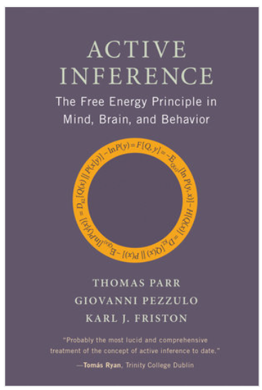
Active Inference: Learning Resources
Active Inference: The Free Energy Principle in Mind, Brain, and Behavior (Parr et. al, 2022).
Canonical open-source textbook for Active Inference, from theory to model construction and analysis and inter-field comparison
“A step-by-step tutorial on active inference and its application to empirical data” (Smith et. al, 2022).
in-depth explanation of Active Inference, building POMDPs, fitting data to models, complemented with MATLAB code examples
The Fundamentals of Active Inference (Namjoshi, forthcoming).
Forthcoming two-volume textbook on Active Inference, complemented with Python code examples
“pymdp: A Python library for active inference in discrete state spaces”
(Heins et. al, 2022) : https://pymdp-rtd.readthedocs.io/en/latest/
Python package, incl. accessible Colab tutorial scripts, e.g., data structure fundamentals, free energy minimization, T-maze and multi-armed bandit examples
“Constructing cultural landscapes: Active Inference for the Social Sciences” (Active Inference Institute, 2023).
Twelve-lecture series on applying Active Inference conceptual framework to, e.g., collective behavior, norm generation and diffusion, shared cultural reality
Notes:
Parr, T., Pezzulo, G., & Friston, K. J. (2022). Active Inference: The Free Energy Principle in Mind, Brain, and Behavior. MIT Press. https://direct.mit.edu/books/oa-monograph/5299/Active-InferenceThe-Free-Energy-Principle-in-Mind
Smith, R., Schwartenbeck, P., Parr, T., & Friston, K. J. (2022). A step-by-step tutorial on active inference and its application to empirical data. Journal of Mathematical Psychology, 107, 102632
Namjoshi, Sanjeev (forthcoming). The Fundamentals of Active Inference. MIT Press.
Heins, C., Millidge, B., Demekas, D., Klein, B., Friston, K., Couzin, I. D., & Tschantz, A. (2022). pymdp: A Python library for active inference in discrete state spaces. Journal of Open Source Software, 7(73), 4098. https://doi.org/10.21105/joss.04098[2]
https://www.activeinference.org/education/active-inference-for-the-social-sciences

Slide 30
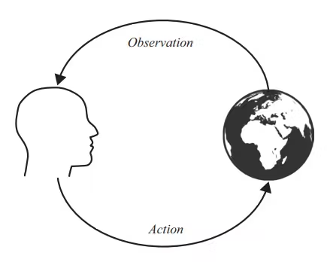
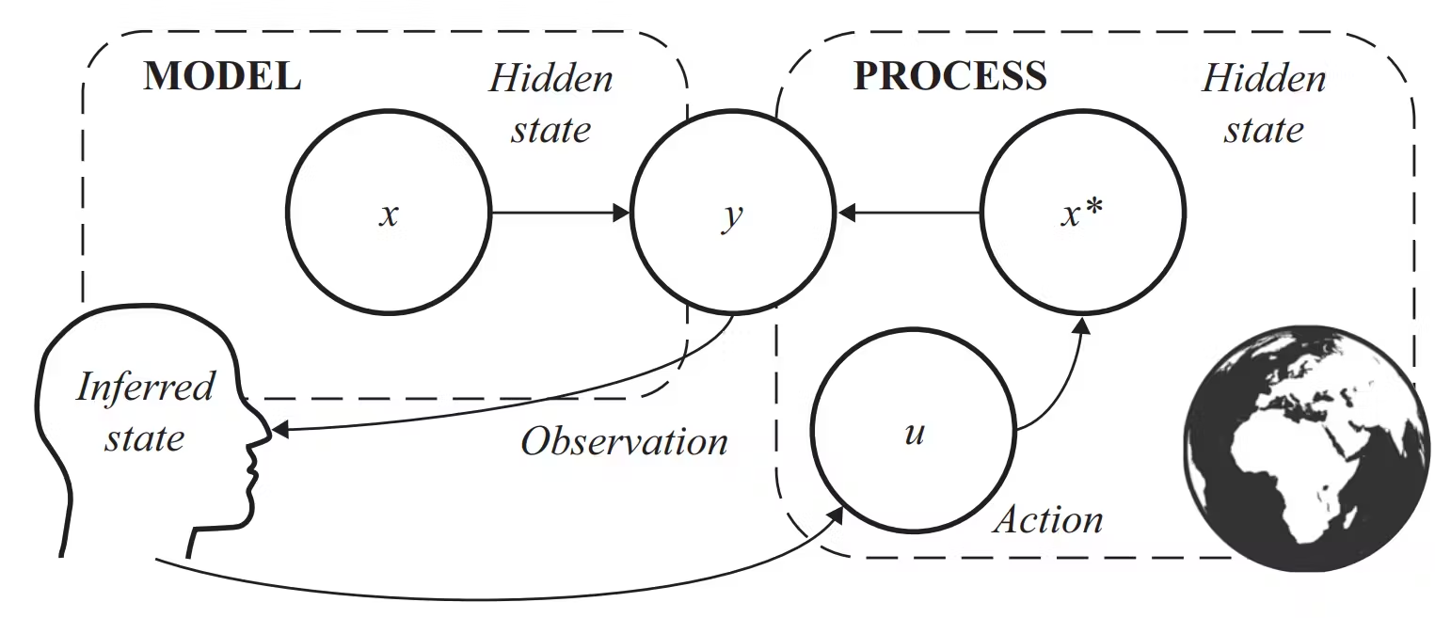
From ABM to Active Inference:
Inference-based action-selection
Rules-based
Inference-based
—--
(Friston et. al, 2022)
Notes:
Textbook Figure 1.1 & Figure 2.2
ABM’s often involve hard-coded rules for agent action-selection: an agent takes in an observation from its environment and consequently elicits the corresponding action. Agents therefore maintain a one-to-one relationship with the state of the world. Active Inference instead draws from predictive processing theories: agents have their own beliefs about the true state of the world, to which the agent in reality has no direct access, thus we call we ‘hidden’ or ‘latent’ states. The agent can only receive sensory observations from the world to make its own inferences about these hidden or latent states.

Slide 31
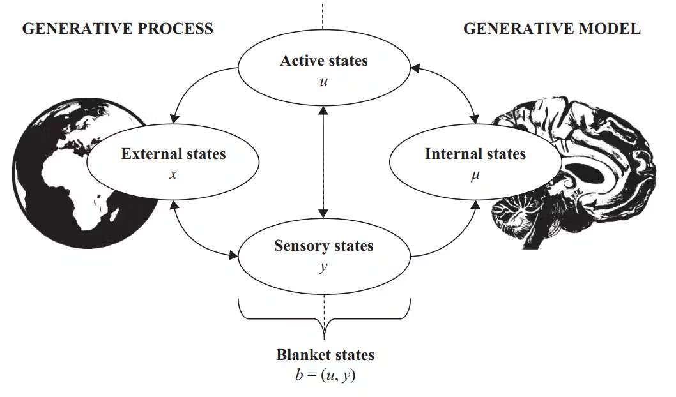
Markov Blanket
The agent-environment relationship can be seen as the relationship between a generative model (agent) and a generative process (environ)
These two entities come into contact via an action-perception loop as the agent makes inferences about its environment and acts based on FEP
Map is not the territory:
An agent’s internal states might come to mirror the environment’s states, but there is no necessity of an identity
“Knock on wood”...
Without separation between ‘system’ and ‘not-system’, there is no surprise: a system (agent) without homeostatic preferences (to maintain for survival) succumbs to its environment
Example: Markov chains with temporal dynamics do not require the past for the present to influence the future
(Friston et. al, 2022)
“An important precondition for any adaptive system is that is must enjoy some separation and autonomy from the environment–without which it would simply dissipate, dissolve, and thereby succumb to environmental dynamics.”
—--
Notes:
Textbook, Figure 6.1
Action-perception loop between an adaptive system (here, the brain) and the environment, along with the Markov blanket (composed of active states and sensory states) that mediates their interaction. The figure implies that the adaptive system only affects the environment by performing actions (via active states) and that the environment only affects the adaptive system by producing observations (via sensory states). The figure exemplifies the distinction between the adaptive system’s generative model and the (external) generative process that produces its observations.
pp.42-43: An important precondition for any adaptive system is that it must enjoy some separation and autonomy from the environment—without which it would simply dissipate, dissolve, and thereby succumb to environmental dynamics. In the absence of this separation, there would be no surprise to minimize; there must be something to be surprised and something to be surprised about. In other words, there are at least two things—system and environment—and these can be disambiguated from one another. A formal way to express a separation between a system and the rest of the environment is the statistical construct of a Markov blanket (Pearl 1988);
A Markov blanket is an important recurring concept in this book (Friston 2019a, Kirchhoff et al. 2018, Palacios et al. 2020). Technically, a blanket (b) is defined as follows: µ ⊥ x|b ⇔ p(µ,x|b) = p(µ|b)p(x|b) This says (in two different but equivalent ways) that a variable μ is conditionally independent of a variable x if b is known. In other words, if we know b, knowing x would give us no additional information about μ. A common example of this is a Markov chain, where the past causes the present causes the future. In this scenario, the past may only influence the future via the present. This means no additional information about the future is gained by finding out about the past (assuming we know the present). To identify a Markov blanket in a system wherein we know the conditional dependencies, we can follow a simple rule. The blanket for a given variable comprises its parents (the variables it depends on), its children (the variables that depend on it) and, in some settings, the other parents of its children.

Slide 32
Inverse Problem:
Hidden states are the causes to be inferred
Observations/
outcomes:
- Interoception
(from within)
- Exteroception
(from outside)
- Proprioception
(position and
movement in space)
Hidden states
(prior beliefs), their relation to observations (likelihoods), and how to change them through action (transitions):
- Beliefs held/
encoded in memory
- Planning
“Your brain receives sense data from the world, sights and sounds and smells and so on. And it receives sense data from the body. And so when there's a loud bang or a tug in your chest, your brain receives that information as the outcomes of some set of causes. But what caused that loud bang? … What caused that tug in your chest? … Your brain actually doesn't know. It only receives the outcomes. It has to guess at what the causes are. This is called an inverse problem. You know what the outcome is, you don't know what the cause is. And so your brain has one other source of information available to it. And that is past experience, memory. So it's not like you walk around consciously remembering things in order to perceive the world. Your brain is constantly remembering, meaning it is constantly reassembling bits and pieces of past experience in order to make sense of what's going on in the body, in relation to the world so that your brain knows what to do next.” (Feldman Barrett, 2021).
—--
Notes:
Lisa Feldmann-Barrett, neuroscientist of affect and emotion and professor of psychology at Northeastern University
Interview with the American Psychological Association’s podcast channel, “Speaking of Psychology: Your brain is not what you think it is, with Lisa Feldman Barrett, PhD”
https://www.apa.org/news/podcasts/speaking-of-psychology/brain-myths
‘Observations’ or ‘outcomes’ are generated from hidden causes in the environment which the brain can only infer, not directly access. Observations are often categorized into three major sensory modalities or categories: exteroception (what comes from outside), interoception (what comes from inside), and proprioception (relating to one’s sense of their position and movement in space).
Full(er) quote: The brain is “constantly trying to make sense of the world [and] what's going on inside the body in relation to what's going on around us outside in the world. And it's doing this using past experience and it's always doing this… your brain receives sense data from the world, sights and sounds and smells and so on. And it receives sense data from the body. And so when there's a loud bang or a tug in your chest, your brain receives that information as the outcomes of some set of causes. But what caused that loud bang? Is it a car backfiring? Is it somebody slamming a door? Is it a gunshot? What's happening? What caused that tug in your chest? Is it anxiety? Is it that you overate that you have heartburn from eating a too rich of a meal? Is it the beginning of a heart attack? Your brain actually doesn't know. It only receives the outcomes. It has to guess at what the causes are. This is called an inverse problem. You know what the outcome is, you don't know what the cause is. And so your brain has one other source of information available to it. And that is past experience, memory. So it's not like you walk around consciously remembering things in order to perceive the world. Your brain is constantly remembering, meaning it is constantly reassembling bits and pieces of past experience in order to make sense of what's going on in the body, in relation to the world so that your brain knows what to do next.”

Slide 33
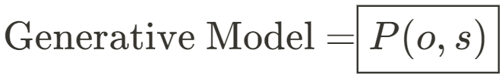
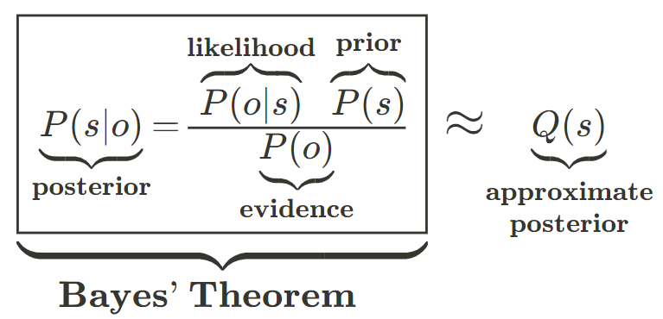
Bayesian Inference and Biology
Bayesian Brain Hypothesis:
Perception is not a purely bottom-up passive process of inferring states from observations (sensory info).
Instead, cognitive inference involves combining prior knowledge about hidden states with incoming observations to compute a resultant posterior distribution over hidden states given the new observations. This posterior then can update the prior for the next step.
Uncertainty and biases: weak likelihoods can diminish impact of new evidence, strong likelihoods can overweight new evidence
Biological/metabolic constraints:
Approximate inference is needed to overcome the intractability of exact inference in most biologically plausible scenarios
—--
Notes:
We can formalize this idea of the brain’s “inverse problem” as a Bayesian inference problem: the brain is a kind of generative model, a joint distribution over observations and states.
This can be broken down into various marginal components: the brain has prior expectations about states, how they map to observations, and by taking in new observations the brain can update its expectations about states of the world given the new observations
c.f. difference between statistical and Bayesian inference
Textbook:
pp. 15-16: There is a long tradition of seeing the brain as a “predictive machine,” or a statistical organ that infers and predicts external states of the world. This idea dates back to the notion of “perception as unconscious inference” (Helmholtz 1866). More recently, this has been reformulated as the “Bayesian brain” hypothesis (Doya 2007). From this perspective, perception is not a purely bottom-up transduction of sensory states (e.g., from the retina) into internal representations of what is out there (e.g., as patterns of neuronal activity). Rather, it is an inferential process that combines (topdown) prior information about the most likely causes of sensations with (bottom-up) sensory stimuli. Inferential processes operate on probabilistic representations of states of the world and follow Bayes’ rule, which prescribes the (optimal) update in the light of sensory evidence. Perception is not a passive outside-in process—in which information is extracted from impressions on our sensory epithelia from “out there.” It is a constructive inside-out process—in which sensations are used to confirm or disconfirm hypotheses about how they were generated (MacKay 1956, Gregory 1980, Yuille and Kersten 2006, Neisser 2014, A. Clark 2015). In turn, performing Bayesian inference requires a generative model— sometimes referred to as a forward model. A generative model is a construct from statistical theory that generates predictions about observations. It may be formulated as the joint probability P(y,x) of observations y and the world’s hidden states x that generate these observations. The latter are referred to as hidden or latent states as they cannot be observed directly. This joint probability can be decomposed into two parts. The first is a prior P(x), which denotes the organism’s knowledge about the hidden states of the world prior to seeing sensory data. The second is the likelihood P(y | x), which denotes the organism’s knowledge of how observations are generated from states. Bayes’ rule tells us how to combine these two elements, essentially updating a prior probability P(x) into a posterior probability of hidden states after receiving observations P(x | y). For readers who need a brief refresher on basic probability theory, box 2.1 provides a summary.

Slide 34
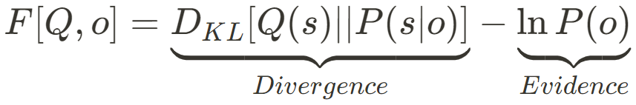
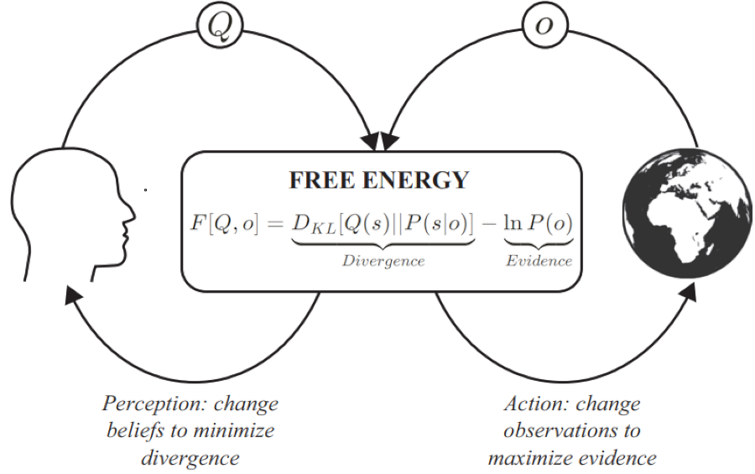
ABC(DEFG)’s of Inference
“F”: Variational free energy
- recall that agent’s are self-evidencing: they seek evidence for their generative model
- they seek to minimize surprise, -lnP(o) (negative
log model evidence), but
this is often intractable (e.g., high number of states to be marginalized out; intractable integrals in continuous cases)
- Instead, free energy – an upper bound on surprisal – is minimized
Notes:
Friston, Textbook, Figure 2.5 (adapted)

Slide 35
ABC(DEFG)’s of Inference
“F”: Variational free energy
- a functional of Q (agent’s approximate beliefs) and observations (from the environment)
- Divergence:
Kullback-Leibler divergence between the inferred (approximate) distribution over states, and the model’s posterior distribution over states
- Evidence:
Incoming observations
( “ln” for easing mathematical
operations involved)
Notes:
Friston et. al, 2022, Textbook, Figure 2.5 (adapted)

Slide 36
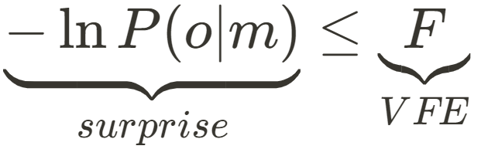
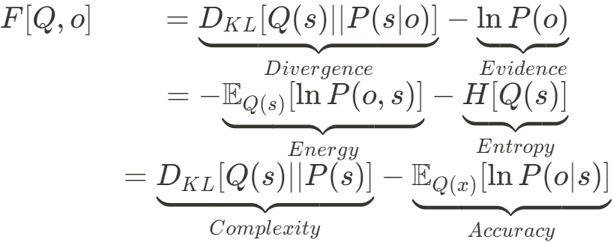
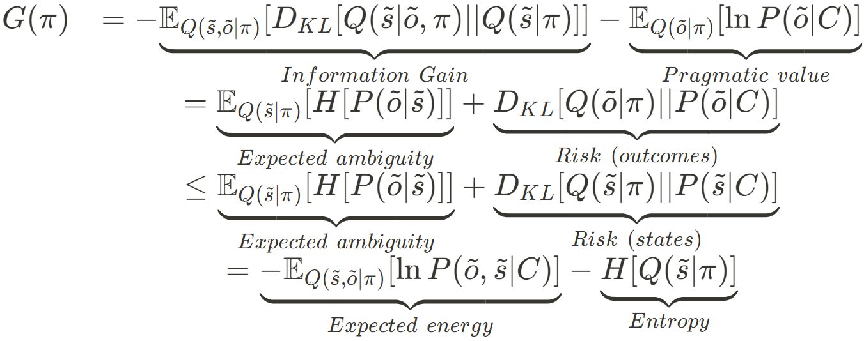
Active Inference and the FEP, in brief
With Bayes’ theorem, we can relate various variables (states, observations, actions), as probability distributions (agent beliefs)..
“Variational free energy” (VFE), and
planning variant “expected free energy” (EFE), inherit from statistical physics, capturing distributional divergences and dissipation – in Active Inference, this is applied to the belief states of agents.
VFE has been used more generally
in ML and study of open,
nonequilibrium steady state systems,
e.g., neuronal dynamics.
—--
(Friston et. al, 2022)
Notes:
Firston, textbook, Box 3.2

Slide 37
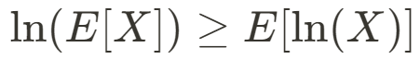
Active Inference and the FEP, in brief
Agents continuously minimize VFE via perception/action in real-time, minimizing the divergence between their prior beliefs and their new posterior beliefs given new observations. VFE acts as a (tractable, variational) bound on (intractable) surprisal (negative log model evidence) via exploiting Jensen’s Inequality.
Expected free energy, unique to organisms capable of “planning,” is for evaluating and selecting actions (pi) based on expected info gain and pragmatic value.
EFE uniquely involves agents’
‘preferences’ (‘C’ term) (ibid).
Computation is carried out via gradient descent on free energy as the variables/distributions are related and updated via message passing schemes, often visualized and scheduled on normal/Bayesian factor graphs.
—--
(Friston et. al, 2022)
Notes:
Firston, textbook, pp.24-25

Slide 38
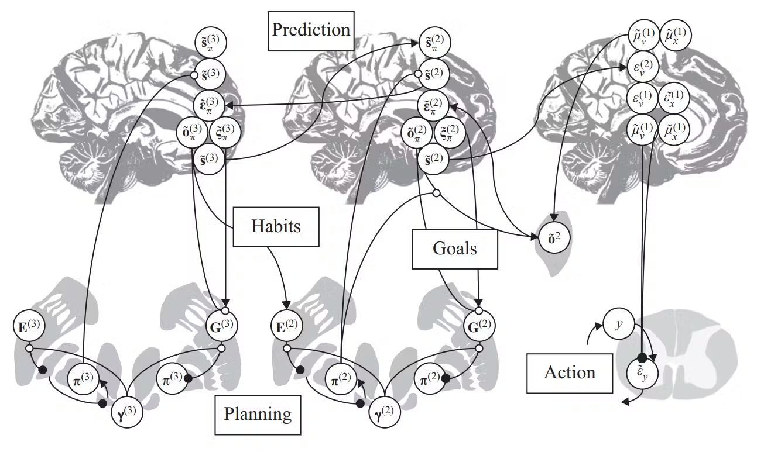
Anatomy of Inference
Active Inference theorizes the relationships between neurobiological and computational architectures
Model variables/parameters map to various cognitive processes
Free energy / prediction error minimization is carried out via message passing schemes on factor graphs
This tutorial will focus on discrete-time POMDP models, but message passing schemes for free energy minimization can in principle be applied to any probabilistic factor graph model
(Friston et. al, 2022)
—
Notes:
Textbook, Figure 5.5
Anatomy of inference (based on Friston, Parr, and de Vries 2017) connects schematics from figures 5.1–5.4, providing a summary of the ideas in this chapter. Two hierarchical loops through the cortex and basal ganglia highlight the distinction between habits—based on input from higher levels—and the more context-sensitive, goaldirected (explorative and exploitative) behavior resulting from expected free energy minimization. Note the influence of inferences about policies on s, implementing the Bayesian model averaging under policies referred to in the main text. This projection from basal ganglia to cortex may be mediated by intermediate structures, such as the thalamus. On the right, the categorical POMDP-based messages are relayed into a continuous predictive-coding network, involved in generation of action. Each categorical state is associated with an alternative prediction of continuous variables and contributes to a prediction error. The message in the opposite direction computes the posterior probability of the associated categorical outcome (o), which depends on priors based on the policy-dependent outcome (oπ), beliefs about the policy (π), and the likelihood of the continuous trajectory that may be computed from posterior expectations ( μ) and variances (not shown) at the continuous level. More connections could be included here; for instance, in addition to habits (E), the selection of goals (C from chapter 4) is itself likely to depend on higher hierarchical levels, leading to hierarchical control of motivation (see Pezzulo, Rigoli, and Friston 2018 for details).

Slide 39
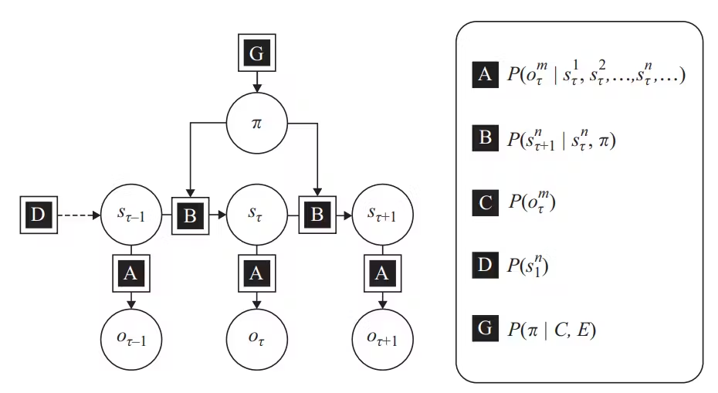
Modeling Inference: Variables in an Active Inference POMDP
POMDP (partially-observable Markov decision-making processes) are the exemplar discrete-time models used in Active Inference, which entails the following key variables and characteristics:
- As before:
observations - “o”
states - “s”
priors - “D”
likelihoods - “A”
- Action
- habits - “E” (priors over policies)
- “policies” (sequences of actions; hypotheses about how to minimize free energy) - “pi”
- Preferences - “C” (priors over observations)
- Transitions of hidden states - “B”
- conditioned on actions/“policies” (pi), the temporal dimension of the model
—
Notes:
Textbook, Figure 7.3
“POMDP from figure 4.3, unpacking the probability distributions in terms of hidden state factors and outcome modalities. (Figure 7.1 is a special case of this structure.) Three points of note: First, the factorization of the hidden states now means that the distribution encoded by A has (potentially) many state factors in its conditioning set and can no longer be encoded by a matrix. Instead, this becomes a tensor object, in which each index corresponds to a state factor. Second, the separation of the outcomes into different modalities means there will be a separate A tensor for each modality. Third, while C and E appear in the panel on the right, they do not appear in the factor graph on the left because they only get into the generative model via prior beliefs about policies. For an alternative perspective on this, see Parr and Friston (2018d) and van de Laar and de Vries (2019).”

Slide 40
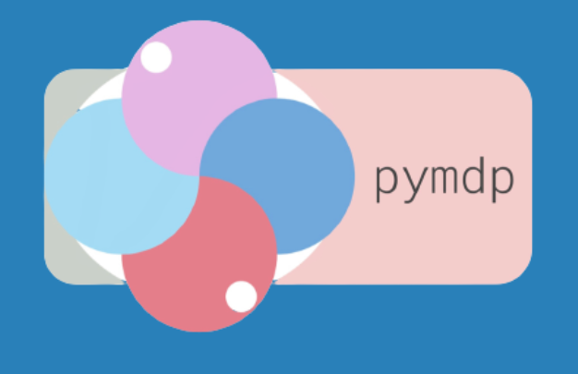
From ABM to Active Inference:
Inference-based action-selection
Coming next:
ABC(DEFG)’s of Inference
defining components needed for constructing an ActInf POMDP agent
minimizing free energy (F, G)
policy inference
“learning”
Constructing a single agent
plug our defined objects into the pymdp Agent() constructor
these are the same agents used in the multi-agent ABM walkthrough in Part 3
Single-agent inference example
constructing a simple action-perception loop and storing/plotting results
https://pymdp-rtd.readthedocs.io/en/latest/
Please access the Google Colab script in the tutorial github site if you have not done so!
https://github.com/apashea/IC2S2-Active-Inference-Tutorial
Notes:
<break>

Slide 41
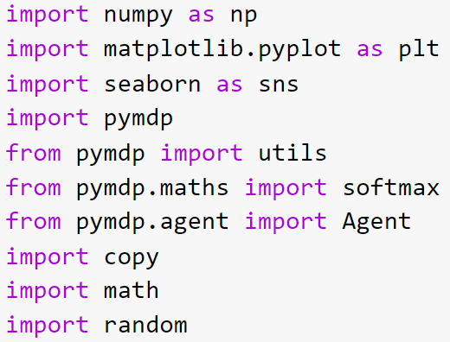
From ABM to Active Inference:
Inference-based action-selection
Coming next:
ABC(DEFG)’s of Inference
defining components needed for constructing an ActInf POMDP agent
minimizing free energy (F, G)
policy inference
“learning”
Constructing a single agent
plug our defined objects into the pymdp Agent() constructor
these are the same agents used in the multi-agent ABM walkthrough in Part 3
Single-agent inference example
constructing a simple action-perception loop and storing/plotting results
https://pymdp-rtd.readthedocs.io/en/latest/
Notes:
<break>

Slide 42
Designing discrete-time Active Inference agents
POMDP (c.f. “Chapter 6” & “Chapter 7” in Friston et. al, 2022):
Defining states: what are agents uncertain about?
Defining observations: what do agents observe from their environment?
Defining controls/actions/policies: what can agents do to interact with their environment?
Actions: discrete actions an agent can take at a given timestep
Controls: types of actions which are considered by the agent to actually change environmental states (e.g., rat can choose left/right arm in T-maze, but cannot impact reward location)
Policies: sequences of actions about which agent has beliefs, i.e. planning
Defining A, B, C, D, E: probability distributions representing agent-beliefs relating states, observations, controls – i.e. beliefs-based framework
Defining our environment: what takes in the agent’s actions and outputs observations?
Define the Active-Inference loop and run as simulation: agent receives observations, infers states, learns, infers policies, commits an action
Comparison and revision in relation to results and literature/domain knowledge (goal: reproduce empirical findings, e.g., of social dynamics, psychological or cognitive features, etc., then tune and explore counterfactuals)

Slide 43
From ABM to Active Inference: Inference-based action-selection
Agent we will construct:
Imagine an agent whose task is to find a good solution to a complex task/problem. They always ‘prefer’ (expect) to find better solutions to the problem than the solution they have currently. In the following single-agent simulation, the agent is assumed to be in a network with one neighbor (for demonstration, we only construct our agent).
At each discrete timestep during an action-perception loop, this agent…
…can choose from two actions/controls/policies*: to ‘explore’ new solutions alone, or to ‘exploit’ their neighbor (by stealing their answer)
…infers an ‘attention’ hidden state: who they infer who they are attending
- ‘explore’ links to attending to ‘self’ with full certainty (probability 1.0)
- ‘exploit’ links to attending to ‘neighbor’ with full certainty (probability 1.0)
- Thus the agent will always know who it is attending to (i.e. fully informative transition model) based on its chosen action
…receives two observations: who they are attending, and whether or not they achieve an ‘improvement’ in their current solution or ‘no improvement’ in their current solution
…learns the relationship between observed improvement outcomes and the attention state of who are attending – i.e. they learn who they should attend to in order to see an ‘improvement’ in their solution.
*note: explore/exploit here are actions – they are not necessarily equivalent to the ‘explore/exploit’ dilemma. For goal-drive expected free energy minimization, each action can have its own exploratory or pragmatic value. The nomenclature used
simply aligns with the names of the actions in the Lazer-Friedman model.
Notes:
<break>

Slide 44
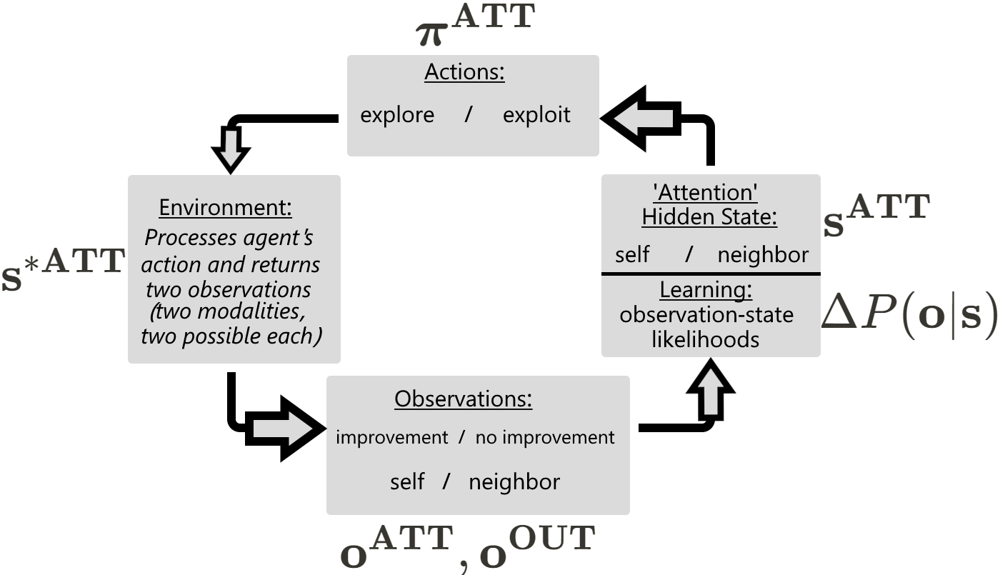
Single-agent
Action-perception loop
Agent we will construct:
Imagine an agent whose task is to iteratively improve their solution to a complex task.
Notes:
<break>

Slide 45
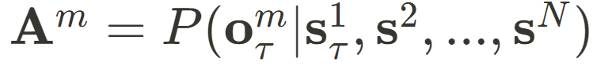
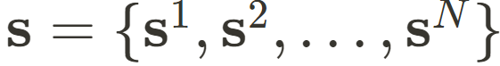
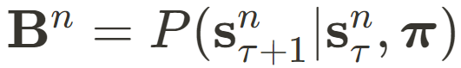
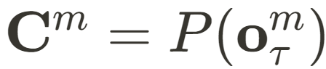
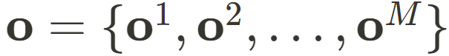
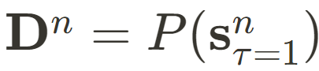
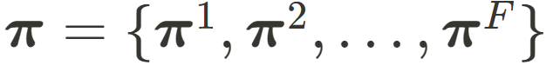
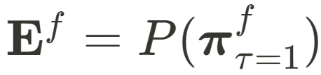
ABC(DEFG)’s of Inference
First define what we
will be relating in the model:
(Hidden) States
separated into N hidden state factors, each with their own discrete levels (discrete states)
Observations/outcomes
separated into M outcome modalities, each with their own discrete levels (discrete observations)
Controls/actions/policies
separated into F control factors, each with their own discrete levels (discrete actions)
Link as categorical distributions:
“A matrix” : likelihood model
- one matrix per outcome modality
“B matrix” : transition model
- one matrix per hidden state factor
“C matrix” : preferences
- one vector per outcome modality
“D matrix” : priors over initial states
- one vector per hidden state factor
“E matrix” : habits
- one vector per control factor
Notes:
Now that we have defined our hidden states, observations, and actions
Textbook, Figure 7.3
“POMDP from figure 4.3, unpacking the probability distributions in terms of hidden state factors and outcome modalities. (Figure 7.1 is a special case of this structure.) Three points of note: First, the factorization of the hidden states now means that the distribution encoded by A has (potentially) many state factors in its conditioning set and can no longer be encoded by a matrix. Instead, this becomes a tensor object, in which each index corresponds to a state factor. Second, the separation of the outcomes into different modalities means there will be a separate A tensor for each modality. Third, while C and E appear in the panel on the right, they do not appear in the factor graph on the left because they only get into the generative model via prior beliefs about policies. For an alternative perspective on this, see Parr and Friston (2018d) and van de Laar and de Vries (2019).”

Slide 46
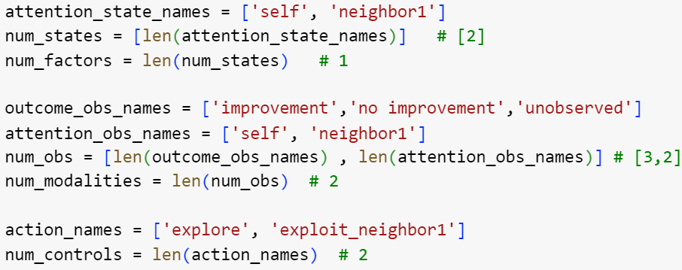
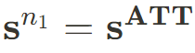
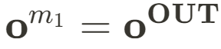
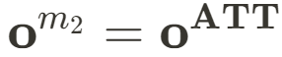
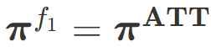
ABC(DEFG)’s of Inference
Example: An agent in a two-agent network (self and one neighbor)
“Attention” (ATT) hidden state factor with 2 discrete states
“Outcome” (OUT) observation modality with 3 discrete observations
“Attention” (ATT) observation modality with 2 discrete observations
“Attention” (ATT) control factor with 2 discrete controls (actions)
- Our agent infers if attending to self or neighbor, observes improvement or not + whom they are attending, and can ‘explore’ or ‘exploit_neighbor1’
First we set discrete names for each and store their lengths
Notes:
Textbook, Figure 7.3
“POMDP from figure 4.3, unpacking the probability distributions in terms of hidden state factors and outcome modalities. (Figure 7.1 is a special case of this structure.) Three points of note: First, the factorization of the hidden states now means that the distribution encoded by A has (potentially) many state factors in its conditioning set and can no longer be encoded by a matrix. Instead, this becomes a tensor object, in which each index corresponds to a state factor. Second, the separation of the outcomes into different modalities means there will be a separate A tensor for each modality. Third, while C and E appear in the panel on the right, they do not appear in the factor graph on the left because they only get into the generative model via prior beliefs about policies. For an alternative perspective on this, see Parr and Friston (2018d) and van de Laar and de Vries (2019).”

Slide 47
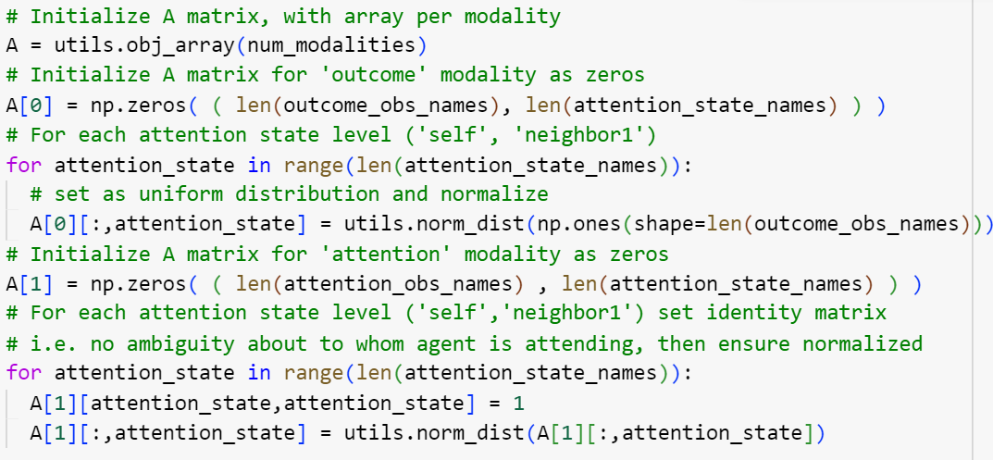
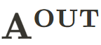
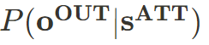
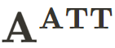
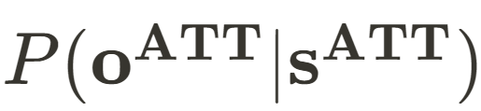
ABC(DEFG)’s of Inference
“A matrix”: likelihood model describing agent’s beliefs regarding the conditional probability of an outcome given the hidden state(s)
We need one subarray A[i] per outcome modality
Array structure: B[i][ ‘observation’ , ‘state factor 1’, ‘state factor 2’, … ]

Slide 48
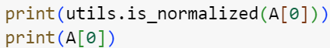
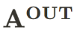
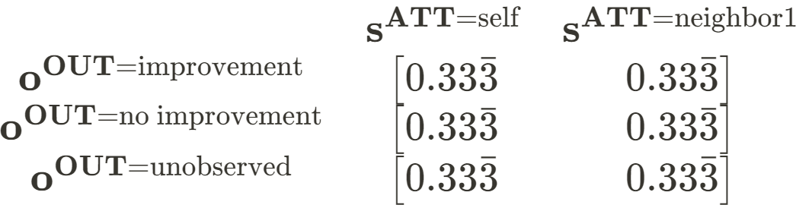
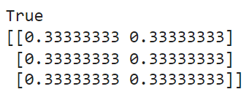
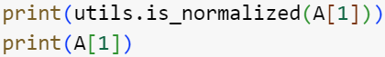
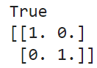
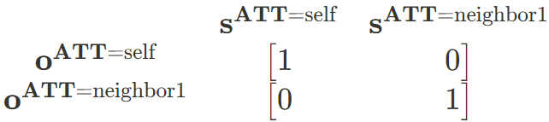
ABC(DEFG)’s of Inference
“A matrix”: likelihood model describing agent’s beliefs regarding the conditional probability of an outcome given the hidden state(s)
Notes:
Each row is an observation and each column is a hidden state
- if there were one more hidden state factor, this would make each A matrix subarray 3-dimensional rather than 2-dimensional. with many hidden state factors, we could see the rise in complexity as all of these matrices are involved in free energy minimization at each time step
- note that this is still a POMDP, not MDP: though the agent (believes itself to have) perfect knowledge about the hidden state in relationship to who it is attending, it still maintains a probabilistic relationship over this relationship; with the ability to ‘learn’ the A matrix, if the agent ever confronted a mismatch between the attention state and attention observation, these probability values would change.
- more clearly, it also still has maximum uncertainty over the hidden state in relation to the ‘outcome’ modality

Slide 49
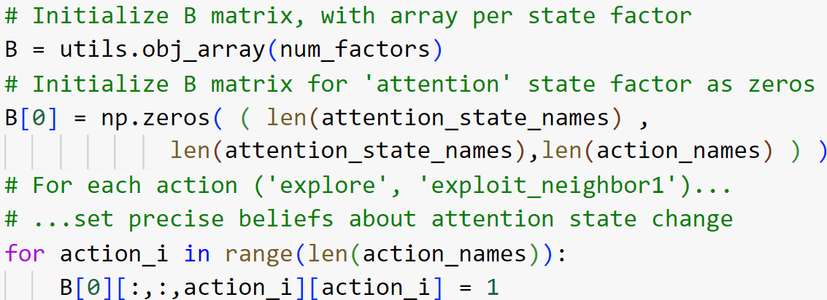
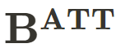
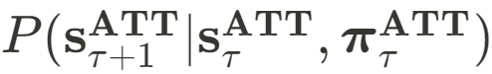
ABC(DEFG)’s of Inference
“B matrix”: transition model describing agent’s beliefs regarding the conditional probability of the hidden state at the next time step, given the current hidden state and an action performed
Ex. “If I explore, the state will transition from self or neighbor to self”
We need one subarray B[i] per state factor, here just one
Array structure: B[i][ ‘state at t+1’ , ‘state at t’ , ‘action’ ]
Notes:
- The subarrays will necessarily be 3D: with one control factor (whose actions are explore / exploit_neighbor1) and one transition to account for, we have a 3D array [state_t+1, state_t, action]
- Here we only have one hidden state factor and one control factor for impacting the state (as far as the agent believes), so we only need one B subarray, B[0].
- Here the agent perfectly believes that if it explores, it will transition attending to itself, and that if it exploits its neighbor, then it will transition to attending to its neighbor.
- So we simply set probability to 1 where this relationship aligns.

Slide 50







ABC(DEFG)’s of Inference
“B matrix”: transition model describing agent’s beliefs regarding the conditional probability of the hidden state at the next time step, given the current hidden state and an action
Notes:
Each array corresponds to the state at the next time step, each row to the current time step, each column to an action which can impact that state transition
Easier to read from inside-out, for example:
column 1: if the agent chooses action ‘explore’ …
row 1: if if the current attention state is ‘self’...
array 1: then the agent believes it will transition to attention state ‘self’ with probability 1.0
so clearly this distribution is perfectly informative: explore transitions to self regardless of the current state, and the same for exploit transitioning to neighbor1

Slide 51





ABC(DEFG)’s of Inference
“C matrix”: preferences (priors over observations) denoting the outcomes the agent prefers (or not) and will thus seek out (or avoid) in a goal-directed manner. Since these are probability distributions, agents are seeking the outcomes they already expect most, i.e. “self-evidencing”.
Here for the ‘outcome’ modality, the agent strongly prefers ‘improvement’, disprefers ‘no improvement’, and is indifferent to ‘unobserved’. We then softmax the distribution to sum to 1 with non-negative values.
We need one subvector C[i] per outcome modality

Slide 52






ABC(DEFG)’s of Inference
“C matrix”: preferences (priors over observations) denoting the outcomes the agent prefers (or not) and will thus seek out (or avoid) in a goal-directed manner. Since these are probability distributions, agents are seeking the outcomes they already expect most, i.e. “self-evidencing”.
*
*Note the softmax amplification
*

Slide 53






ABC(DEFG)’s of Inference
“D matrix”: priors over initial states, the agent’s beliefs about the current hidden state at the start of the simulation (t=1)
We will use a discrete uniform distribution, i.e. the agent is uncertain as to who it is initially attending to

Slide 54




ABC(DEFG)’s of Inference
“E matrix”: ‘habits’, i.e. priors over initial actions/policies
learned over time when repeatedly relied upon to minimize free energy, resulting in heuristics-like, context-free (‘belief-free’) actions to be used in high ambiguity scenarios. This risks keeping agent in local optima and/or committing suboptimal actions (Friston, 2016).
- note: pymdp can automatically construct the E matrix based on how certain argument are defined; we define them explicitly here for clarity

Slide 55

Learning
Agents learn– update/modulate their internal variables/parameters – typically at a slower timescale than real-time perceptual inference.
This may be coded to occur after every X timesteps, or at the end of an entire trial, depending on the use case/assumptions.
This timescale differentiation is supported by literature on learning, e.g., memory consolidation, LTM/STM, fast vs. slow neurotransmitters. This mediates the impact of new observations on the model (Friston et. al, 2016; Smith et. al, 2020).
Computationally, this occurs by assigning Dirichlet distributions (conjugate to categorical distributions) as hyperparameters to our variables.
These hyperparameters are thus priors (beliefs about) the variables themselves.
—
Notes:
- (LTM/STM: long-term versus short-term/working memory)
“An Active Inference Approach to Modeling Structure Learning: Concept Learning as an Example Case” (Smith et. al, 2020).
“Active inference and learning” (Friston et. al, 2016).
Textbook, pp.141, Figure 7.10
This generative model for learning uses the same POMDP structure as in figure 7.3, but the priors for each of the hidden states now depend on variables (in circles), which themselves now come equipped with prior beliefs. These have the form of Dirichlet distributions, which are conjugate (see box 7.2) to the categorical distributions considered thus far. The model shows how the likelihood of outcomes given states now also depends on a variable A (which is the same for all time-points), the transition probabilities are now conditioned on a variable B, the preferences depend on C, the initial states depend on D, and the fixed form policy prior depends on E. By making prior beliefs about the parameters of the generative model explicit, this figure emphasizes that both inference and learning are free energy minimizing processes, but they are distinct. In short, inference describes the optimization of beliefs about the state of the world as it is (s), including beliefs about the way in which we are acting (π). In contrast, learning describes optimization of beliefs about the relationships between these variables (A, B, C, D, or E). The latter vary much more slowly than the former and may only be learned when the states have been inferred. We will return to this separation of timescales below when we consider hierarchical generative models

Slide 56






Learning
Here our agent will ‘learn’ their likelihood model, i.e. the probabilistic associations they have made between states and observations contained in the
A matrix.
We will assign ‘pA’ (prior beliefs about A) to our agent, a Dirichlet distribution – ‘pseudo-counts’ – conjugate to our original A matrix of categorical distributions (notice same structure in code). This lets the agent compare posteriors about A to a prior about A for Bayesian belief updating.
The ‘scale’ argument will scale the priors before we assign them to the agent. This will up- or down-weight the impact of experience (how much learning will impact the agent’s beliefs) and relates to precision modulation and synaptic plasticity (ibid).
This can be related to the agent’s “confidence” in its beliefs about how outcomes map to states.
Notes:
c.f. pymdp document (arxiv):
“An Active Inference Approach to Modeling Structure Learning: Concept Learning as an Example Case” (Smith et. al, 2020).
“Active inference and learning” (Friston et. al, 2016).
Equations: Textbook, B.2.3 in Appendix (pp.247) on “Learning”:
“These [equations] simply say that when the thing predicted by the relevant term in the probability distribution comes to pass (which may be a combination of two things for conditional probabilities), we simply augment that element of the probability array to signal that it is more likely to happen again in the future.
Textbook, pp.141, Figure 7.10
This generative model for learning uses the same POMDP structure as in figure 7.3, but the priors for each of the hidden states now depend on variables (in circles), which themselves now come equipped with prior beliefs. These have the form of Dirichlet distributions, which are conjugate (see box 7.2) to the categorical distributions considered thus far. The model shows how the likelihood of outcomes given states now also depends on a variable A (which is the same for all time-points), the transition probabilities are now conditioned on a variable B, the preferences depend on C, the initial states depend on D, and the fixed form policy prior depends on E. By making prior beliefs about the parameters of the generative model explicit, this figure emphasizes that both inference and learning are free energy minimizing processes, but they are distinct. In short, inference describes the optimization of beliefs about the state of the world as it is (s), including beliefs about the way in which we are acting (π). In contrast, learning describes optimization of beliefs about the relationships between these variables (A, B, C, D, or E). The latter vary much more slowly than the former and may only be learned when the states have been inferred. We will return to this separation of timescales below when we consider hierarchical generative models

Slide 57

ABC(DEFG)’s of Inference
Constructing our agent using the Agent constructor:
We simply plug in our defined variables into the call to Agent() which will house the agent’s beliefs, parameters, memory, etc. as class attributes
- inference_algo= ‘MMP”‘ : specifies that we will use ‘marginal message passing’ as the particular message passing scheme for belief updating and free energy minimization. This algorithm strikes a balance between variational message passing (found to produce overconfident posteriors) and belief propagation (computationally expensive) (Parr et. al, 2019).
- In a more recent (non-pip) pymdp update, among other various new features (jax back-end, model fitting developments), the ‘sophisticated’ argument has been added for allowing sophisticated inference, optimizing policy tree search (Friston et. al, 2021; and Hodson et. al, 2023). This would be useful in cases of more actions available and/or longer policy lengths, e.g., 4 actions, 5-step policies = 4^5 = 1024 policies to evaluate (!).
Notes:
“Neuronal message passing using Mean-field, Bethe, and Marginal approximations” (Parr et. al, 2019).
“Sophisticated Inference” (Friston et. al, 2021). https://direct.mit.edu/neco/article-abstract/33/3/713/97487/Sophisticated-Inference
“Planning to Learn: A Novel Algorithm for Active Learning during Model-Based Planning” (Hodson et. al, 2023).

Slide 58
ABC(DEFG)’s of Inference
Constructing our agent using the Agent constructor:
We simply plug in our defined variables into the call to Agent()
Other arguments:
policy_len=1 : agents will only plan their actions one step into the future, as they have relatively simple one-step actions (explore or exploit)
inference_horizon=2 : the agent will try to infer states for both t and t+1 (into the future), figuring into expected free energy for policy inference and evaluation
sampling_mode = ‘full’ : agent will select actions to take based on the full posterior over policies computed during policy inference
action_selection = ‘stochastic’: agent will sample actions from their posterior beliefs over policies probabilistically (rather than ‘deterministic’ where action with highest posterior probability is necessarily chosen)
Notes:
“Sophisticated Inference” (Friston et. al, 2021). https://direct.mit.edu/neco/article-abstract/33/3/713/97487/Sophisticated-Inference
“Planning to Learn: A Novel Algorithm for Active Learning during Model-Based Planning” (Hodson et. al, 2023).

Slide 59
ABC(DEFG)’s of Inference
With these variables in place and the agent now constructed, the agent can now iteratively:
- infer states based on incoming observations
agent.infer_states(obs)
- learn/update its model parameters based on incoming observations
agent.update_A(obs) ←—---- used in this tutorial
agent.update_B(qs_prev)
agent.update_D()
- infer actions/policies to commit next
agent.infer_policies()
agent.sample_action()
Notes:
“Sophisticated Inference” (Friston et. al, 2021). https://direct.mit.edu/neco/article-abstract/33/3/713/97487/Sophisticated-Inference
“Planning to Learn: A Novel Algorithm for Active Learning during Model-Based Planning” (Hodson et. al, 2023).

Slide 60



ABC(DEFG)’s of Inference
Hidden State inference: in pymdp, using Marginal Message Passing, variational free energy (VFE) is computed per policy.
see also: pymdp manual free energy calculation
- Receiving observations and inferring states: in pymdp, observations appear as vectors (Python: lists) whose indices are observation modalities and values are observation levels
Notes:
“Active inference and learning” (Friston et. al, 2016). Appendix.

Slide 61

ABC(DEFG)’s of Inference
Policy inference/selection:
VFE is computed per timestep for each policy during state inference:
Complexity: the VFE value for a given policy will be greater if the agent’s (approximate) belief about the current hidden state given the policy is far from the transition model’s prediction of what the state should be given the policy
- our agent has perfect awareness of transitions of the relationship between policies and states (the B matrix is an identity matrix), thus complexity is zero
Accuracy: the VFE value for a given policy will be greater if the agent’s likelihood model does not predict the current observation very well
- with zero complexity, and accuracy as a negative term, our agent’s VFE values per policy will always be equivalent to each other, negative, and oscillate based on observations received versus the A matrix’s ability to predict them
Notes:
“Active inference and learning” (Friston et. al, 2016). Appendix.

Slide 62







ABC(DEFG)’s of Inference
State inference & Learning:
- in the step using agent.infer_states(obs) we stored the `qs` it returned
- our example’s agent will always have perfect awareness of the state it’s in, so in this particular case the results are not particularly interesting…
- …but being able to extract this information can be useful in use-cases involving uncertain states… and in our case, for learning
- Q(s): the resultant approximate posterior over states using the ‘MMP’ algorithm has the following complex structure:
- qs[policy index][timestep index][hidden state factor]
= current beliefs (at t)
Notes:
The structure of the approximate posteriors when using MMP is more complex: qs is an array for each policy. in each policy subarray is an array for the inference timestep. and within each inference timestep (sub)-subarray is the categorical distribution for the states expected (at that timestep under that policy).
Rephrased, arrays are policies, rows are timesteps, and columns are hidden states.
Notice here that the agent simply believes if it chooses ‘explore’, it will move to the ‘self’ attention state (and if it chooses ‘exploit neighbor1’ then it will move to the ‘neighbor’ attention state) with virtually full certainty, reflecting the transition model.

Slide 63

ABC(DEFG)’s of Inference
Policy inference/selection:
- How agents update their beliefs about actions (and which to take)
- Some nomenclature:
- “Action” : a particular action an agent can take
- “Control” : an action an agent can take to actually impact (i.e. ‘control’)
states, as represented in the B matrix
- actions/controls often denoted “a” or “u”
- “Policy” : a sequence of actions whose length depends on the agent’s
policy length
- policies often denoted by pi
- Example: “explore at t, explore at t+1” is a two-step policy to explore
twice in a row:
Our example agents will only have policies of length one since the task is the same at each timestep (argument: “policy_len = 1”)

Slide 64
ABC(DEFG)’s of Inference
Policy inference/selection:
- “posterior beliefs over policies”: categorical distribution over expected policies, determining policy selection
- in our example, with action_selection= “stochastic”, agent will probabilistically sample from this distribution
- ex. if Q(pi) = [0.7, 0.3], agent will choose ‘explore’ with prob 0.7 and ‘exploit’ with prob 0.3
- “VFE” : Variational free energy (here, computed per policy)
- “EFE” : Expected free energy (here, computed per policy)
- minimized in planning, taking into account epistemic and pragmatic value of actions to be taken
- Gamma : ‘action precision’ in range [0,1], relating to agent’s confidence in its action model; up-/down-weights influence of agent’s planning
- “Habits” : as seen previously (pi subscript for uniformity of notation and reminder of similar structure to VFE_pi and EFE_pi)

Slide 65

ABC(DEFG)’s of Inference
Policy inference/selection:
EFE is computed per timestep for each policy during policy inference:
- Information gain: also referred to as epistemic value – the value derived from learning new information – the expected difference between agent’s posterior beliefs given new observations given a policy and agent’s prior beliefs given a policy. Thus unlike VFE’s emphasis on minimizing divergence, EFE tries to maximize this difference.
-Pragmatic value: the probability of new observations given their assumed prior probabilities (‘preferences’), weighted by their probability given the policy.
As with various other optimization problems, the logarithm is used for easing computation (sums rather than products).
Notes:
Equation 4.9, Textbook, pp. 73
Info gain: D_KL between posteriors and priors, how much new observations made inferred states diverge from the priors, to be maximized
Pragmatic value: how well C (a categorical probability distribution) describes a sequence of observations: each observation in the sequence is matched to its respective probability in C (ex. \tilde{o}={a,b,a} and C=[a=0.5,b=0.5] -> P(\tilde{o}|C) = 0.5*0.5*0.5=0.125 -> ln(0.125)=~ -2.0794 -> E[ln P(\tilde{o}|C)] is the expected value of this log-likelihood over all possible sequences $$\tilde{o}$$ that could be generated from the distribution $$C$$.
In brief, it’s useful in prob theory and ML more broadly as it:
quantifies how well the prob dist explains the observed data
it’s often used in MLE to find parameters of $C$ that best fit the observed data
The logarithm is used to turn products into sums (easier to work with)
expected value gives an average measure of fit across all possible sequences, not just for one specific sequence. This expectation is often approximated by averaging over a large number of observed sequences, or calculated analytically if the distribution allows for it.
Here with the subscript, $\ln P(\tilde{o}|C)$ is being calculated w.r.t prob dist $Q(\tilde{o}|\pi)$:
$P(\tilde{o}|C)$ can be interpreted just as is $P(\tilde{o}|C)$: it is the probability of the observations conditioned on the probabilities in \pi (or C).
this expectation with the subscript can be interpreted as a weighted average, where the weights are determined by the probability distribution $(\tilde{o}|\pi$
For each possible sequence $\tilde{o}$, we calculate $\ln P(\tilde{o}|C)$ (multiplying each obs by its associated prob in C)
then we weight each of these terms by the probability of that sequence occurring according to $Q(\tilde{o}|\pi)$
finally we sum up these weighted values
so if obs are [a,b,a] and C=[a=0.5,b=0.5] and pi=[a=0.2,b=0.8] then we would have for P(\tilde{o}|c) = 0.5*0.5*0.5=0.125. Then we take the log, ln(0.125) =~ -2.0794. then weighting, we have P(\tilde{o}|\pi)=weight_value (a sequence given a policy is associated with a particular prob thus a scalar). We actually do this process for all possible sequences of observations, then take the expectation. So, with C we have a means of ‘scoring’ observations (by having the model presume they all have associated prior probabilities, figuratively how much they ‘prefer’ each observation), but multiplying them by their probability given a policy. If the sequence is very likely given
So if the probability of Q(\tilde{o}|\pi^{explore}) is very high
You could have obs=[a_{t},a_{t+1}] and C=[a=0.9,b=0.1] (a is highly preferred) , so P(obs|C)=0.9*0.9=0.81. we take ln(0.81)=~ -0.2107. But pi might be [a=0.5,b=0.5] so that P(obs|pi)=0.25, which then gets weighted -0.2107*0.25.
We could say that if the probability of observations is low given a policy as well as given C, the result will be a low probability. If prob is high for C but low for the policy, the prob will go up (the agent expects it) but believes less able to realize it (the agent doesn’t find it probable given the policy they’re evaluating): “I want it but doing this won’t help”. Has to want it + believe they can do it.
This type of expectation is often used in ML/info theory, often in variational inference or comparing prob distributions; it allows measuring the average log-likelihood of sequences generated by one distribution (Q(obs|pi) under another distribution (P(obs|C)), useful for model comparison/optimization.
If the observed outcomes have high prob values given the policy, and they are highly preferred (high prior probs), the pragmatic value will be higher.
“Note that pragmatic value emerges as a prior belief about observations, where the C-parameters of this distribution may be chosen to reflect the sort of system we are interested in characterizing (in terms of its characteristic or preferred outcome states).” pp. ~73
“This decomposition of the expected free energy into epistemic and pragmatic value highlights the (epistemic) drive toward information gathering and the (pragmatic) drive toward realizing prior beliefs (C in figure 7.3). We will attempt to provide a deeper intuition for the epistemic value in the next section, but it can be thought of simply as the amount of information we stand to gain under a specific policy. The form of the pragmatic value effectively treats the probability of outcomes, averaged over all policies, as if it were a prior. In doing so, those policies with consequences consistent with this prior become more probable, as they are associated with lower expected free energy. To put this in more intuitive terms, if we consider a certain sort of observation to be very probable, we will act to fulfill our belief that we will encounter these. Therefore, the log probability of outcomes may be thought of as equivalent to a utility function in other formalisms, such as optimal control theory and reinforcement learning. The fact that utility and the value of information emerge as two components of the expected free energy means that we do not need to worry about balancing exploration and exploitation. Both are in service of optimizing the same function.” pp. 131 (Chapter 7, “Active Inference in Discrete Time”)

Slide 66

ABC(DEFG)’s of Inference
Policy inference/selection:
EFE is computed per timestep for each policy during policy inference:
- Expected Ambiguity: the expected entropy, or ‘inaccuracy,’ of state-observation mappings, ex. P(o=Heads|s=raining) will be maximally ambiguous as P(o=Heads|s=sunny) would be equally likely (one-to-many observation-state mappings).
- Risk: as the agent accumulates observations and actions histories, this is the divergence between the probability of new data given the policy and given preferences, respectively. Figuratively, the difference between what the agent expects to happen given policies and what the agent prefers. Relatable to ‘expected complexity’, higher when there are one-to-many mappings between policies and outcomes, ex. stochastic one-armed bandits (‘slot machines’). Relatable to ‘risk’ in economics or control theory
Notes:
Equation 4.9, Textbook, pp. 73
Info gain: D_KL between posteriors and priors, how much new observations made inferred states diverge from the priors, to be maximized
Pragmatic value: how well C (a categorical probability distribution) describes a sequence of observations: each observation in the sequence is matched to its respective probability in C (ex. \tilde{o}={a,b,a} and C=[a=0.5,b=0.5] -> P(\tilde{o}|C) = 0.5*0.5*0.5=0.125 -> ln(0.125)=~ -2.0794 -> E[ln P(\tilde{o}|C)] is the expected value of this log-likelihood over all possible sequences $$\tilde{o}$$ that could be generated from the distribution $$C$$.
In brief, it’s useful in prob theory and ML more broadly as it:
quantifies how well the prob dist explains the observed data
it’s often used in MLE to find parameters of $C$ that best fit the observed data
The logarithm is used to turn products into sums (easier to work with)
expected value gives an average measure of fit across all possible sequences, not just for one specific sequence. This expectation is often approximated by averaging over a large number of observed sequences, or calculated analytically if the distribution allows for it.
Here with the subscript, $\ln P(\tilde{o}|C)$ is being calculated w.r.t prob dist $Q(\tilde{o}|\pi)$:
$P(\tilde{o}|C)$ can be interpreted just as is $P(\tilde{o}|C)$: it is the probability of the observations conditioned on the probabilities in \pi (or C).
this expectation with the subscript can be interpreted as a weighted average, where the weights are determined by the probability distribution $(\tilde{o}|\pi$
For each possible sequence $\tilde{o}$, we calculate $\ln P(\tilde{o}|C)$ (multiplying each obs by its associated prob in C)
then we weight each of these terms by the probability of that sequence occurring according to $Q(\tilde{o}|\pi)$
finally we sum up these weighted values
so if obs are [a,b,a] and C=[a=0.5,b=0.5] and pi=[a=0.2,b=0.8] then we would have for P(\tilde{o}|c) = 0.5*0.5*0.5=0.125. Then we take the log, ln(0.125) =~ -2.0794. then weighting, we have P(\tilde{o}|\pi)=weight_value (a sequence given a policy is associated with a particular prob thus a scalar). We actually do this process for all possible sequences of observations, then take the expectation. So, with C we have a means of ‘scoring’ observations (by having the model presume they all have associated prior probabilities, figuratively how much they ‘prefer’ each observation), but multiplying them by their probability given a policy. If the sequence is very likely given
So if the probability of Q(\tilde{o}|\pi^{explore}) is very high
You could have obs=[a_{t},a_{t+1}] and C=[a=0.9,b=0.1] (a is highly preferred) , so P(obs|C)=0.9*0.9=0.81. we take ln(0.81)=~ -0.2107. But pi might be [a=0.5,b=0.5] so that P(obs|pi)=0.25, which then gets weighted -0.2107*0.25.
We could say that if the probability of observations is low given a policy as well as given C, the result will be a low probability. If prob is high for C but low for the policy, the prob will go up (the agent expects it) but believes less able to realize it (the agent doesn’t find it probable given the policy they’re evaluating): “I want it but doing this won’t help”. Has to want it + believe they can do it.
This type of expectation is often used in ML/info theory, often in variational inference or comparing prob distributions; it allows measuring the average log-likelihood of sequences generated by one distribution (Q(obs|pi) under another distribution (P(obs|C)), useful for model comparison/optimization.
If the observed outcomes have high prob values given the policy, and they are highly preferred (high prior probs), the pragmatic value will be higher.
“Note that pragmatic value emerges as a prior belief about observations, where the C-parameters of this distribution may be chosen to reflect the sort of system we are interested in characterizing (in terms of its characteristic or preferred outcome states).” pp. ~73
“This decomposition of the expected free energy into epistemic and pragmatic value highlights the (epistemic) drive toward information gathering and the (pragmatic) drive toward realizing prior beliefs (C in figure 7.3). We will attempt to provide a deeper intuition for the epistemic value in the next section, but it can be thought of simply as the amount of information we stand to gain under a specific policy. The form of the pragmatic value effectively treats the probability of outcomes, averaged over all policies, as if it were a prior. In doing so, those policies with consequences consistent with this prior become more probable, as they are associated with lower expected free energy. To put this in more intuitive terms, if we consider a certain sort of observation to be very probable, we will act to fulfill our belief that we will encounter these. Therefore, the log probability of outcomes may be thought of as equivalent to a utility function in other formalisms, such as optimal control theory and reinforcement learning. The fact that utility and the value of information emerge as two components of the expected free energy means that we do not need to worry about balancing exploration and exploitation. Both are in service of optimizing the same function.” pp. 131 (Chapter 7, “Active Inference in Discrete Time”)

Slide 67




ABC(DEFG)’s of Inference
Policy inference/selection:
EFE is computed per timestep for each policy during policy inference:
as the agent learned (updated its A matrix), it has evidence for ‘explore’
Notes:
Equation 4.9, Textbook, pp. 73
Info gain: D_KL between posteriors and priors, how much new observations made inferred states diverge from the priors, to be maximized
Pragmatic value: how well C (a categorical probability distribution) describes a sequence of observations: each observation in the sequence is matched to its respective probability in C (ex. \tilde{o}={a,b,a} and C=[a=0.5,b=0.5] -> P(\tilde{o}|C) = 0.5*0.5*0.5=0.125 -> ln(0.125)=~ -2.0794 -> E[ln P(\tilde{o}|C)] is the expected value of this log-likelihood over all possible sequences $$\tilde{o}$$ that could be generated from the distribution $$C$$.
In brief, it’s useful in prob theory and ML more broadly as it:
quantifies how well the prob dist explains the observed data
it’s often used in MLE to find parameters of $C$ that best fit the observed data
The logarithm is used to turn products into sums (easier to work with)
expected value gives an average measure of fit across all possible sequences, not just for one specific sequence. This expectation is often approximated by averaging over a large number of observed sequences, or calculated analytically if the distribution allows for it.
Here with the subscript, $\ln P(\tilde{o}|C)$ is being calculated w.r.t prob dist $Q(\tilde{o}|\pi)$:
$P(\tilde{o}|C)$ can be interpreted just as is $P(\tilde{o}|C)$: it is the probability of the observations conditioned on the probabilities in \pi (or C).
this expectation with the subscript can be interpreted as a weighted average, where the weights are determined by the probability distribution $(\tilde{o}|\pi$
For each possible sequence $\tilde{o}$, we calculate $\ln P(\tilde{o}|C)$ (multiplying each obs by its associated prob in C)
then we weight each of these terms by the probability of that sequence occurring according to $Q(\tilde{o}|\pi)$
finally we sum up these weighted values
so if obs are [a,b,a] and C=[a=0.5,b=0.5] and pi=[a=0.2,b=0.8] then we would have for P(\tilde{o}|c) = 0.5*0.5*0.5=0.125. Then we take the log, ln(0.125) =~ -2.0794. then weighting, we have P(\tilde{o}|\pi)=weight_value (a sequence given a policy is associated with a particular prob thus a scalar). We actually do this process for all possible sequences of observations, then take the expectation. So, with C we have a means of ‘scoring’ observations (by having the model presume they all have associated prior probabilities, figuratively how much they ‘prefer’ each observation), but multiplying them by their probability given a policy. If the sequence is very likely given
So if the probability of Q(\tilde{o}|\pi^{explore}) is very high
You could have obs=[a_{t},a_{t+1}] and C=[a=0.9,b=0.1] (a is highly preferred) , so P(obs|C)=0.9*0.9=0.81. we take ln(0.81)=~ -0.2107. But pi might be [a=0.5,b=0.5] so that P(obs|pi)=0.25, which then gets weighted -0.2107*0.25.
We could say that if the probability of observations is low given a policy as well as given C, the result will be a low probability. If prob is high for C but low for the policy, the prob will go up (the agent expects it) but believes less able to realize it (the agent doesn’t find it probable given the policy they’re evaluating): “I want it but doing this won’t help”. Has to want it + believe they can do it.
This type of expectation is often used in ML/info theory, often in variational inference or comparing prob distributions; it allows measuring the average log-likelihood of sequences generated by one distribution (Q(obs|pi) under another distribution (P(obs|C)), useful for model comparison/optimization.
If the observed outcomes have high prob values given the policy, and they are highly preferred (high prior probs), the pragmatic value will be higher.
“Note that pragmatic value emerges as a prior belief about observations, where the C-parameters of this distribution may be chosen to reflect the sort of system we are interested in characterizing (in terms of its characteristic or preferred outcome states).” pp. ~73
“This decomposition of the expected free energy into epistemic and pragmatic value highlights the (epistemic) drive toward information gathering and the (pragmatic) drive toward realizing prior beliefs (C in figure 7.3). We will attempt to provide a deeper intuition for the epistemic value in the next section, but it can be thought of simply as the amount of information we stand to gain under a specific policy. The form of the pragmatic value effectively treats the probability of outcomes, averaged over all policies, as if it were a prior. In doing so, those policies with consequences consistent with this prior become more probable, as they are associated with lower expected free energy. To put this in more intuitive terms, if we consider a certain sort of observation to be very probable, we will act to fulfill our belief that we will encounter these. Therefore, the log probability of outcomes may be thought of as equivalent to a utility function in other formalisms, such as optimal control theory and reinforcement learning. The fact that utility and the value of information emerge as two components of the expected free energy means that we do not need to worry about balancing exploration and exploitation. Both are in service of optimizing the same function.” pp. 131 (Chapter 7, “Active Inference in Discrete Time”)

Slide 68



ABC(DEFG)’s of Inference
Learning the A matrix:
- For learning we extract the posterior over states only for the current timestep given the policy chosen, qs[policy chosen][current timestep]
- The agent’s original A matrix for the ‘outcome’ modality was perfectly uncertain. After one observation of ‘improvement’ + ‘self’ and running learning, the agent has up-weighted the probability of ‘improvement’ given state ‘self’ –
it now associates the ‘self’ state with ‘improvement’ more
**We will see shortly how the agent actually chooses actions
This agent needs learning to adapt
Notes:
The inferred probability distribution over expected states at the current timestep is needed for running the learning update for the A matrix
Notice the observations ‘improvement’ in the ‘outcome’ modality and ‘self’ in the ‘attention’ modality led the agent to upweight the association between ‘improvement’ and the ‘self’ attention state – this functions similarly to associational learning and synaptic gain, amplifying the association relative to the other potential associations.
The second array for attention observations and attention states remains the same, i.e. perfectly informative – nothing has occurred which would change the agent’s beliefs about this
**Note: for demonstration of learning, we have to force a hypothetical action the agent has taken. It’s generally irrelevant for our use-case since the posterior over states at the current timestep will always be the same for either policy–the agent always knows what attention state it is in given based on its action as its fully transition model–B matrix– is fully informative. Note also that again, learning typically occurs on a slower timescale, after more than one timestep, so in the upcoming simulations we will not have to do this – this is for demonstration as we are building up towards an action-perception loop and how it would be coded in the correct order of steps.

Slide 69

Two-stage trial:
‘Neighbor’ (t=0 to t=14):
- initialize obs = [0,1]
- ‘explore’ returns ‘no improvement’ [1,0]
- ‘exploit’ returns ‘improvement’ [0,1]
‘Self’(t=15 to t=29):
- reversal: [0,0] & [1,1]
- F_pi always equal:
negative values
denote both actions are informative
- G for policies
differs based on
expected
epistemic vs.
pragmatic value
Neighbor
Self
Step Order
- the agent adapts well to
Stage 1 in a few trials… but must unlearn during Stage 2
Notes:
Here is the result of an active inference loop run over 30 iterations (python indexes at 0, so ranging t=0 to t=29)
we can read the plot both left-to-right (over time, following the timesteps) as well as top-to-bottom (as these are the order of steps in the loop as coded:
agent receives an observation,
then infers states and computes VFE (F_t),
then goes thru a round of learning conditional on how often the agent is set to learn,
then the agent infers policies which computes EFE (G_t) as well as the posteriors over policies,
and finally the agent chooses an action for the next time step.
**note: the agent is learning outcome-attention probability values, which as we saw are actually updated prior to the ‘G_t’ plot, but I’ve placed them on the ‘Probability’ subplot for sake of trying to keep it more concise.
we initialize the agent with an observation list [0,1] meaning it observes ‘improvement’ and ‘neighbor1’ . then for the remaining first 15 steps (t=1 to t=14 inclusive), the ‘environment' will always send the agent ‘improvement’ if it chooses ‘exploit neighbor1’ as its action but ‘no improvement’ if it explores. at stage 2 this reverses, so that improvement is had from exploring only.
remember the agent’s C matrix was set so that it highly prefers improvements, and disfavors ‘no improvement’.
the agent starts with its habits: it has no F or G computed for its available policies yet, so it can only rely on the E matrix of habits whose values were 0.5 for both policies. Because of the stochastic action selection – it will choose explore with probability 0.5 or exploit with probability 0.5 – it selects randomly. It then gives ‘explore’ a second try – as the G per policy was still the same. But after these two steps of exploring to find no improvement, and with a drop in its improvement-self association from learning, the agent determines EFE to be lower for exploiting instead. It exploits at timestep t=3, sees improvement, and continues this same action as it repeatedly realizes its preferences.
It continues to learn the association improvement|neighbor – nearly reaching full probability by the end of Stage 1.
It has a learning step at the same time as the context changes, however: it learns that maybe this association isn’t as strong as it thought, and it continues unlearning this association as it keeps trying what was previously a very successful policy.
Notice this agent has never witnessed an improvement from exploring instead: it hasn’t had any opportunity to update this association because of its stubbornness. Though the agent would eventually unlearn this policy if the timesteps continued in this context,

Slide 70

Three-stage trial, one learning step:
- as before, except change back to ‘Neighbor’ at t=25
- Without learning: there are no updates to the model’s internal structure – only stochastic choices from current Q(pi)
- Agent only learns once, at t=20, which moves agent in ‘optimal’ direction but no further changes
Neighbor
Neighbor
Self
Step Order
- With only uniform and perfect distributions and no learning, nothing tips decision making away from stochastically choosing explore/exploit with 0.5 probability
Notes:
For demonstration of an agent without learning and uniform/perfect distributions
with perfect transitions, the agent finds expects no epistemic value from ‘trying’ one policy over another, and its observation model remains the same so nothing directs it to thinking it will receive an improvement from a particular attention state (i.e. no pragmatic value is expected, either). Thus G never fluctuates.
again, F remains the same: with perfect knowledge about transitions, the complexity term in computing VFE remains 0, and accuracy fluctuates but is not differentiable between policies.
per our previous equation for policy inference, the agent is stuck with stochastically selecting from its habits
learning is thus necessary for this use-case. here the code is written to force the agent to learn only one time, at t=20: the agent sees a major shift in its policy posteriors as well as expected free energy per policy. this leads to a more “optimal” behavior (relative to the task).

Slide 71
Multi-Agent Application:
Parallel Problem-Solving on an NK Landscape
Coming next:
- We will plug these agents into a modified two-stage version of a paradigmatic ABM simulation for studying parallel problem-solving in networks
ABM: Agents in a network all attempt to find (explore) the best solution individually, but take (exploit) the solution of a network neighbor when one is available. This defines the deterministic behavior of agents per timestep.
- Review the paradigm (Lazer et. al, 2007) (Netlogo code), including its limitations for some policy-related use-cases
- In the tutorial Google Colab script:
- We will look at creating X number of agents in networks and run
simulations – random graphs with connectivity rate p, as well as
identical subnetworks, ex. ‘5 groups of 4 agents’
- Review the summary results for potential insights and value added from
using Active Inference agents
- the metrics collected in the original ABM
- the cognitive metric “Personal Efficacy” from learning A matrix

Slide 72
Multi-Agent Application:
Parallel Problem-Solving on an NK Landscape
ABM: Agents in a network all attempt to find (explore) the best solution individually, but take (exploit) the solution of a network neighbor when one is available. This defines the deterministic behavior of agents per timestep.
This paradigm can be used to study polarization and consensus emergence involved in complex problem-solving as an exploration-exploitation scheme.
Research areas of interest:
- team performance
- social networks
- student group projects
- network dynamics and emergent behavior
- diversity of ideas
Potential parameters to modify:
- network connectivity 0 <= p <= 1
- complexity of problem to be solved (NK Landscape)
- errors in copying (mistakes when exploiting)

Slide 73

Multi-Agent Application:
Parallel Problem-Solving on an NK Landscape
ABM: Agents in a network all attempt to find (explore) the best solution individually, but take (exploit) the solution of a network neighbor when one is available.
Lazer & Friedman (2007) found that:
Densely connected networks
produce fast consensus of agents
around same ‘best’ solution –
which diminishes need for further
problem-solving
Sparsely connected networks lead
to polarization as clusters converge
on distinct solutions – local
consensus with global difference
(potential local optima)
Error-in-copying increases idea
diversity and mitigates fast consensus

Slide 74

NK Landscape
(Levinthal, 1997)
Agents work towards the best solution (ranked by fitness values) in a fitness landscape:
- N components, each
component taking one of
B values (here, binary: B=2)
ex. B^N = 2^10 = 1024 solutions
- K interdependencies
between components
determines how fitness values are assigned to solutions
higher K -> more
complexity (risk of local optimum)
ex. ‘designing a car’
- Agents can be initialized to start with poor solutions and attempt to improve from there
Notes:
Link to original NetLogo script: https://netlogoweb.org/web?url=https%3A%2F%2Fmodelingcommons.org%3A443%2Fbrowse%2F5219%2Fmodel_contents&name=Problem+Solving+in+Networks
Levinthal, D. A. (1997). "Adaptation on Rugged Landscapes". Management Science. 43 (7): 934–950. doi:10.1287/mnsc.43.7.934.

Slide 75

Lazer & Friedman Model (NetLogo)
Agents know the fitness levels of all of their neighbors’ solutions. Deterministically at each timestep they do the following:
- Exploit the best solution of their neighbors if it surpasses the agent’s own solution
ex. if neighbor i’s solution has the best fitness in the network, the agent will take neighbor i’s solution
- Explore new solutions if no neighbor has a better solution by ‘flipping one bit’:
example (N=10, K>1):
current solution at t:
0000000001 with fitness ‘62’
explored solution for t+1:
0000100000 with fitness ‘48
NetLogo code:
—
Notes:
Link to original NetLogo script (interactive): https://netlogoweb.org/web?url=https%3A%2F%2Fmodelingcommons.org%3A443%2Fbrowse%2F5219%2Fmodel_contents&name=Problem+Solving+in+Networks

Slide 76
Lazer & Friedman Model
with ActInf Agents
Agents know the fitness levels of all of their neighbors’ solutions. Deterministically at each timestep they do the following:
- Exploit the best solution of their neighbors if it surpasses the agent’s own solution
ex. if neighbor i’s solution has the best fitness in the network, the agent will take neighbor i’s solution
- Explore new solutions if no neighbor has a better solution by ‘flipping one bit’:
example (N=10, K>1):
current solution at t:
0000000001 with fitness ‘62’
explored solution for t+1:
0000100000 with fitness ‘48
Agents only knows the fitness level of a neighbor’s solution if they ‘attend’ to that neighbor. Agent chooses, based on FEP, at each timestep to do the following:
- Exploit one of their neighbors, revealing that neighbor’s fitness
ex. if chosen neighbor’s solution’s fitness is higher, agent changes to it else keeps current fitness
- Explore new solutions if agent so chooses (based on FEP):
example (N=10, K>1):
current solution at t:
0000000001 with fitness ‘62’
explored solution for t+1:
0000100000 with fitness ‘48
—
Notes:
Link to original NetLogo script (interactive): https://netlogoweb.org/web?url=https%3A%2F%2Fmodelingcommons.org%3A443%2Fbrowse%2F5219%2Fmodel_contents&name=Problem+Solving+in+Networks

Slide 77
Lazer & Friedman Model
with ActInf Agents
Additional modifications/questions:
Consider the long-term impact of the task: If agents actually learn from these experiences, what is the longevity of this performance? Shouldn’t agents perform better on a second trial?
Change: Two-stage trial with a unique NK landscape for each and plot results
What is the impact of this task on agent’s beliefs, for example, their sense of ‘Personal Efficacy’? Are agents better prepared for handling tasks individually and/or collectively going forward?
Change: track P(o=improvement|s=self) over time
Say we have multiple groups – for example a Problems-Based Learning assignment for students – split into N groups of M agents?
Change: additional ‘subgroups’ option for making network into N separate subnetworks of M agents
—
Notes:
Link to original NetLogo script (interactive): https://netlogoweb.org/web?url=https%3A%2F%2Fmodelingcommons.org%3A443%2Fbrowse%2F5219%2Fmodel_contents&name=Problem+Solving+in+Networks

Slide 78


‘Trial 0’ : random network, fully connected, 30 agents
—
Notes:
For this first trial, the fully-connected random graph network with 30 agents, the takeaways are:
it recreates similar dynamics to the Lazer & Friedman model:
agents reach a maximum fitness level over time as they explore/exploit
diversity of ideas indeed goes down over time: agents each have 30 actions available (explore or exploit one of 29 neighbors), so exploiting (or coincidentally exploring) the same solutions more than exploring new ones reduces idea diversity
- however:
- notice: agents’ beliefs in exploring leading to better solutions (i.e. P(improvement|attention to self) where exploring is the action proxy for the latter) : it drops immensely as agents learn to rely more on their peers than on exploring their own solutions; average ‘Personal Efficacy’ beliefs drop to below 0.2 probability by time agents reach the best solution in stage 1.
- this learned pattern continues into stage 2 – agents almost entirely only exploit one another’s answers throughout this entire stage, thus idea diversity stays low throughout stage 2, the max fitness the agents reach takes 4 timesteps longer to get to than in stage 1, and the agents don’t even reach the best possible solution, instead plateauing before the trial is over

Slide 79

‘Trial 1’ : 6 groups of 5 agents, 30 agents in total
Notes:
For an alternative group assignment where agents are instead in small groups with no overlap, here 6 groups of 5 agents, the negative impacts found in the previous fully connected network are somewhat mitigated: agents have fewer neighbors to choose from, and their explore-exploit ratio goes down as agents must explore more often to advance to a better solution.
Interestingly, at least one of the subgroups manages to discover the best possible solution in stage 1 very quickly, at only one-third of the way thru the stage
But of course since it is a separate subnetwork, the agents in the other subnetworks cannot exploit this solution; they must find it themselves. So we see more pronounced differences in the min and max fitness values.
Agents once again learn to exploit more than explore – the only difference is at stage 2, their explore-improve beleifs to increase slightly (probably because they were all initialized with bad solutions, and with a smaller number of neighbors to exploit, someone has to be the ‘first mover’). That said, the agents still take longer to achieve max fitness in stage 2 than in stage 1. The higher diversity of ideas is likely due to the much higher chance that agents will cluster around certain better solutions – the agents themselves are already arranged in their own clusters (subnetworks).

Slide 80
Other considerations
Recreate the original simulation in its entirety
- what would happen if agents can actually see the best solution in their network (own or neighbor’s) and have just two actions, explore and exploit?
- ‘realism’ here: original simulation assumes all agents have full access to other agents’ solutions (if no errors, then also fully ‘understand’ the solutions) at each t
- Assuming uniform habits, would upweight both policies’ priors (0.5, 0.5)
Revise hidden states, observations, actions, and/or learning
- Only one hidden state for ‘attention’ was used with precise beliefs about transitions
- Adding an additional outcome state with uncertain beliefs (if explore then improvement, etc.), and learning the transitions, might change behavior (including VFE, as transitions with uncertainty will make the complexity term non-zero)
- pymdp supports learning A, B, and D matrices; possible to learn other parameters via manually-defined functions possible (see ActInf literature)
- hierarchical models (higher-order layers learn states to be supplied as priors for lower layers)
Experiment with other factors in the literature, e.g., error-in-copying (option is available in tutorial code), superiority bias (only keep exploited solution if its fitness is substantially better), etc. (Boroomand et. al, 2023).
Notes:
Amin Boroomand and Paul E. Smaldino. Superiority Bias and Communication Noise Can Enhance Collective Problem Solving, Journal of Artificial Societies and Social Simulation (2023) https://www.jasss.org/26/3/14.html

Slide 81
Thank you for your time!
andrewbpashea@gmail.com
https://www.linkedin.com/in/andrewbpashea/
pymdp : https://pymdp-rtd.readthedocs.io/en/latest/index.html
Active Inference Institute : https://www.activeinference.org/
Open weekly textbook group, collaborative learning
Projects of varying scales
RxInfer / BIASlab : https://rxinfer.ml/
working with the Engineering group at AII exploring using the julia programming language to optimize computations in ActInf simulations
Additional projects:
computational psychiatry project to study dynamics of belief updating in individuals clinically diagnosed with PTSD, modeling from qualitative data
Prisoner’s Dilemma with Active Inference agents
Notes:
Amin Boroomand and Paul E. Smaldino. Superiority Bias and Communication Noise Can Enhance Collective Problem Solving, Journal of Artificial Societies and Social Simulation (2023) https://www.jasss.org/26/3/14.html

Slide 82
Appendix

Slide 83

ABC(DEFG)’s of Inference
“F”: Variational free energy
- a functional of Q (agent’s approximate beliefs) and observations (from the environment)
We then compute VFE for each policy:
Notes:
Appendix, “Active inference and learning” (Friston et. al, 2016).

Slide 84


ABC(DEFG)’s of Inference
“F”: Variational free energy
“G”: Expected free energy
Notes:
Friston, K., FitzGerald, T., Rigoli, F., Schwartenbeck, P., O'Doherty, J., & Pezzulo, G. (2016). Active inference and learning. Neuroscience & Biobehavioral Reviews, 68, 862-879. https://doi.org/10.1016/j.neubiorev.2016.06.022
Textbook, Figure 7.3
“POMDP from figure 4.3, unpacking the probability distributions in terms of hidden state factors and outcome modalities. (Figure 7.1 is a special case of this structure.) Three points of note: First, the factorization of the hidden states now means that the distribution encoded by A has (potentially) many state factors in its conditioning set and can no longer be encoded by a matrix. Instead, this becomes a tensor object, in which each index corresponds to a state factor. Second, the separation of the outcomes into different modalities means there will be a separate A tensor for each modality. Third, while C and E appear in the panel on the right, they do not appear in the factor graph on the left because they only get into the generative model via prior beliefs about policies. For an alternative perspective on this, see Parr and Friston (2018d) and van de Laar and de Vries (2019).”

Slide 85
ABC(DEFG)’s of Inference
“G”: Expected free energy
based on the premise that agents minimize the expected free energy of future outcomes. Crucially, the negative free energy or quality of a policy can be decomposed into extrinsic and epistemic (or intrinsic) value. Minimizing expected free energy is therefore equivalent to maximizing extrinsic value or expected utility (defined in terms of prior preferences or goals), while maximizing information gain or intrinsic value (or reducing uncertainty about the causes of valuable outcomes). The resulting scheme resolves the exploration-exploitation dilemma: Epistemic value is maximized until there is no further information gain, after which exploitation is assured through maximization of extrinsic value.
Notes:
“Active inference and epistemic value” (Friston et. al, 2015). https://pubmed.ncbi.nlm.nih.gov/25689102/

Slide 86

ABC(DEFG)’s of Inference
“F”: Variational free energy
Notice the similarity between ‘surprise’ and preferences (priors over outcomes)
Notes:
Friston, K., FitzGerald, T., Rigoli, F., Schwartenbeck, P., O'Doherty, J., & Pezzulo, G. (2016). Active inference and learning. Neuroscience & Biobehavioral Reviews, 68, 862-879. https://doi.org/10.1016/j.neubiorev.2016.06.022
Textbook, Figure 7.3
“POMDP from figure 4.3, unpacking the probability distributions in terms of hidden state factors and outcome modalities. (Figure 7.1 is a special case of this structure.) Three points of note: First, the factorization of the hidden states now means that the distribution encoded by A has (potentially) many state factors in its conditioning set and can no longer be encoded by a matrix. Instead, this becomes a tensor object, in which each index corresponds to a state factor. Second, the separation of the outcomes into different modalities means there will be a separate A tensor for each modality. Third, while C and E appear in the panel on the right, they do not appear in the factor graph on the left because they only get into the generative model via prior beliefs about policies. For an alternative perspective on this, see Parr and Friston (2018d) and van de Laar and de Vries (2019).”

Slide 87

ABC(DEFG)’s of Inference
“F”: Variational free energy
Notice the similarity between ‘surprise’ and preferences (priors over outcomes)
Notes:
Friston, K., FitzGerald, T., Rigoli, F., Schwartenbeck, P., O'Doherty, J., & Pezzulo, G. (2016). Active inference and learning. Neuroscience & Biobehavioral Reviews, 68, 862-879. https://doi.org/10.1016/j.neubiorev.2016.06.022
Textbook, Figure 7.3
“POMDP from figure 4.3, unpacking the probability distributions in terms of hidden state factors and outcome modalities. (Figure 7.1 is a special case of this structure.) Three points of note: First, the factorization of the hidden states now means that the distribution encoded by A has (potentially) many state factors in its conditioning set and can no longer be encoded by a matrix. Instead, this becomes a tensor object, in which each index corresponds to a state factor. Second, the separation of the outcomes into different modalities means there will be a separate A tensor for each modality. Third, while C and E appear in the panel on the right, they do not appear in the factor graph on the left because they only get into the generative model via prior beliefs about policies. For an alternative perspective on this, see Parr and Friston (2018d) and van de Laar and de Vries (2019).”

Slide 88

Single agent inference
Now we can feed the agent a single observation and infer the approximate posterior Q(s) via free energy minimization.
Notes:
“An Active Inference Approach to Modeling Structure Learning: Concept Learning as an Example Case” (Smith et. al, 2020).
“Active inference and learning” (Friston et. al, 2016).
Textbook, pp.141, Figure 7.10
This generative model for learning uses the same POMDP structure as in figure 7.3, but the priors for each of the hidden states now depend on variables (in circles), which themselves now come equipped with prior beliefs. These have the form of Dirichlet distributions, which are conjugate (see box 7.2) to the categorical distributions considered thus far. The model shows how the likelihood of outcomes given states now also depends on a variable A (which is the same for all time-points), the transition probabilities are now conditioned on a variable B, the preferences depend on C, the initial states depend on D, and the fixed form policy prior depends on E. By making prior beliefs about the parameters of the generative model explicit, this figure emphasizes that both inference and learning are free energy minimizing processes, but they are distinct. In short, inference describes the optimization of beliefs about the state of the world as it is (s), including beliefs about the way in which we are acting (π). In contrast, learning describes optimization of beliefs about the relationships between these variables (A, B, C, D, or E). The latter vary much more slowly than the former and may only be learned when the states have been inferred. We will return to this separation of timescales below when we consider hierarchical generative models

Slide 89

Single agent inference
Notes:
“An Active Inference Approach to Modeling Structure Learning: Concept Learning as an Example Case” (Smith et. al, 2020).
“Active inference and learning” (Friston et. al, 2016).
Textbook, pp.141, Figure 7.10
This generative model for learning uses the same POMDP structure as in figure 7.3, but the priors for each of the hidden states now depend on variables (in circles), which themselves now come equipped with prior beliefs. These have the form of Dirichlet distributions, which are conjugate (see box 7.2) to the categorical distributions considered thus far. The model shows how the likelihood of outcomes given states now also depends on a variable A (which is the same for all time-points), the transition probabilities are now conditioned on a variable B, the preferences depend on C, the initial states depend on D, and the fixed form policy prior depends on E. By making prior beliefs about the parameters of the generative model explicit, this figure emphasizes that both inference and learning are free energy minimizing processes, but they are distinct. In short, inference describes the optimization of beliefs about the state of the world as it is (s), including beliefs about the way in which we are acting (π). In contrast, learning describes optimization of beliefs about the relationships between these variables (A, B, C, D, or E). The latter vary much more slowly than the former and may only be learned when the states have been inferred. We will return to this separation of timescales below when we consider hierarchical generative models

Slide 90
References
–
See speaker notes
—--
Notes:
Textbook, Figure 6.1
Action-perception loop between an adaptive system (here, the brain) and the environment, along with the Markov blanket (composed of active states and sensory states) that mediates their interaction. The figure implies that the adaptive system only affects the environment by performing actions (via active states) and that the environment only affects the adaptive system by producing observations (via sensory states). The figure exemplifies the distinction between the adaptive system’s generative model and the (external) generative process that produces its observations.
pp.42-43: An important precondition for any adaptive system is that it must enjoy some separation and autonomy from the environment—without which it would simply dissipate, dissolve, and thereby succumb to environmental dynamics. In the absence of this separation, there would be no surprise to minimize; there must be something to be surprised and something to be surprised about. In other words, there are at least two things—system and environment—and these can be disambiguated from one another. A formal way to express a separation between a system and the rest of the environment is the statistical construct of a Markov blanket (Pearl 1988);
A Markov blanket is an important recurring concept in this book (Friston 2019a, Kirchhoff et al. 2018, Palacios et al. 2020). Technically, a blanket (b) is defined as follows: µ ⊥ x|b ⇔ p(µ,x|b) = p(µ|b)p(x|b) This says (in two different but equivalent ways) that a variable μ is conditionally independent of a variable x if b is known. In other words, if we know b, knowing x would give us no additional information about μ. A common example of this is a Markov chain, where the past causes the present causes the future. In this scenario, the past may only influence the future via the present. This means no additional information about the future is gained by finding out about the past (assuming we know the present). To identify a Markov blanket in a system wherein we know the conditional dependencies, we can follow a simple rule. The blanket for a given variable comprises its parents (the variables it depends on), its children (the variables that depend on it) and, in some settings, the other parents of its children.

